Slide 1


February 13, 2026

Slide 2





Sanding Down the Myths of ADHD
Amanda Conrad, PsyD
Associate Professor of Pediatrics
Center for ADHD
Behavioral Medicine and Clinical Psychology
Cincinnati Children’s Hospital Medical Center

Slide 3
Presentation aims
A brief review of psycho education about ADHD
Common myths and misconceptions about ADHD
Provide an overview of effective behavioral and environmental strategies
A review of strategies to engage students in the classroom

Slide 4




The Brain and ADHD
Behavioral Interventions can have a neurological impact

Slide 5
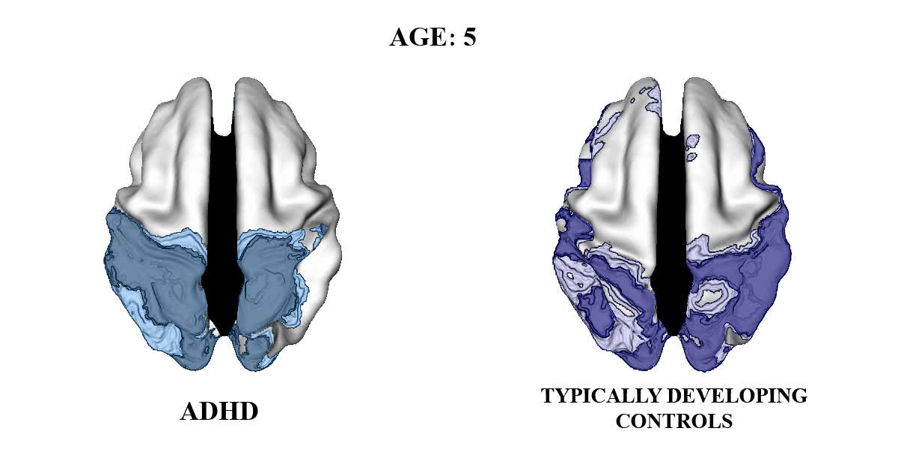
If your brain develops differently, that can make it harder for you to focus and do well in school, at home (across all areas of functioning)

Slide 6
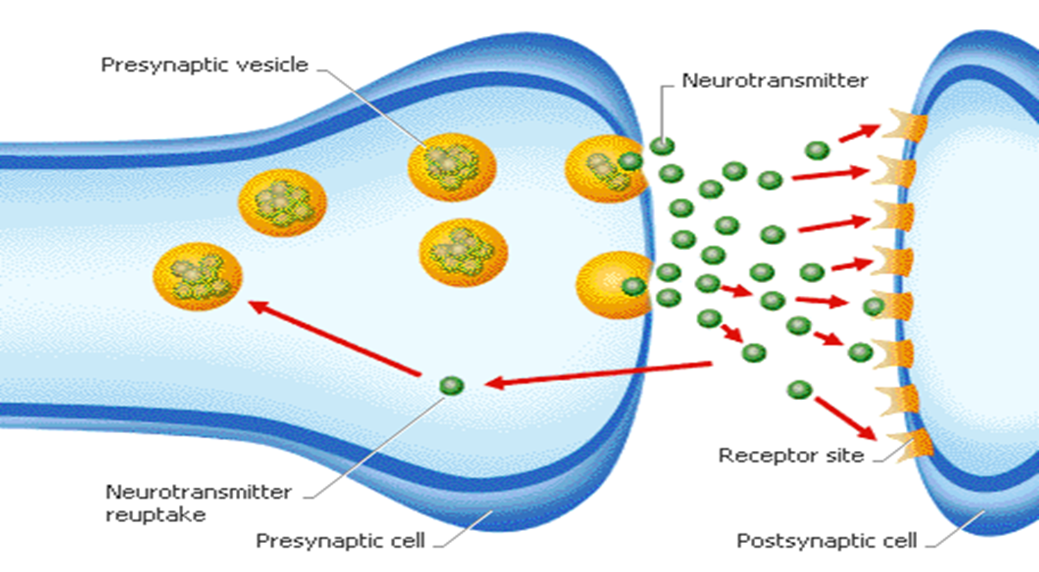

Not just the structure that’s different.
It’s chemical signals too -

Slide 7
When you don’t have enough DA -
Brake.
Filter.
How you process sensory information.
She looks a little...irritated.
Body language is off.
He seems to think I’m funny!
Spatial awareness, handsyness, whether you keep talking or stop. Academically - picking up on context clues, re-engaging where you left off, remembering to hit “Submit”
“Competing for dopamine...”
Notes:
NOT LAZY

Slide 8

ADHD
Facts
vs
Myths

Slide 9

Myth:
Children with ADHD are Lazy.

Slide 10


Neurobiology of ADHD – It’s not just laziness

Slide 11
When you do have enough neurotransmitters
Start work more promptly and easily (motivation)
When you don’t have enough neurotransmitters
Have difficulty starting tasks like homework, laundry, etc.

Slide 12
Myth:
ADHD is caused by bad parenting, the education system, etc.

Slide 13
The environment can affect what problems you may have, but DOES NOT cause ADHD
  ADHD is NOT caused by parenting style, poor classroom management, the stresses of life, or lazy teenagers
  ADHD is often linked to genetics
    Hereditary

Slide 14
Facts about ADHD
ADHD is a neurobiological condition.
Affects all areas of life. (It’s a system).
Expect a 30% delay in performance (not knowledge)

Slide 15
Behavioral and Environmental Strategies
“ADHD is not a disorder of knowing what to do but of doing what one knows.”
Makes it hard to do the things we know, in the moment!

Slide 16
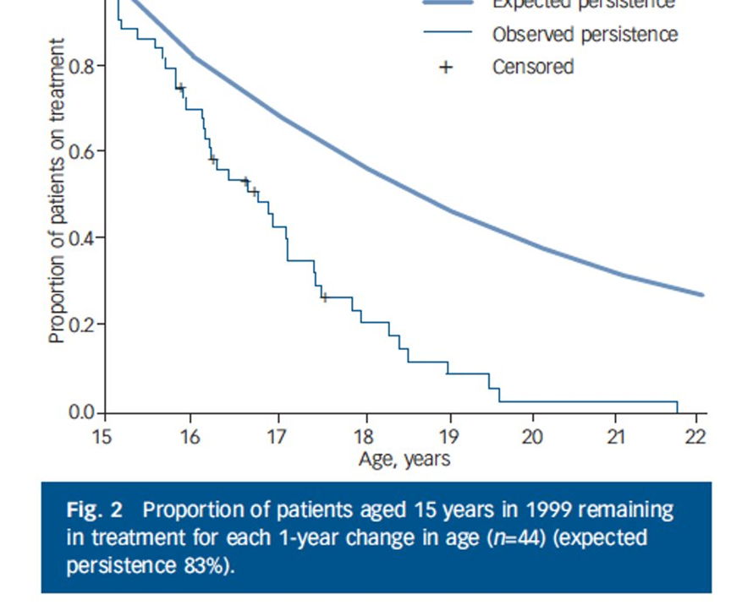
Most children stop stimulant medication at some point
Invest in behavioral interventions that will be worth your time!

Slide 17

Knowledge vs. Performance
Knowing what to do is different from doing it when you need to!
Crossing the street
Parallel Parking
Turning in Homework
Studying for a Test

Slide 18

Behaviorism in a Nutshell
A
B
C
Antecedent
What comes before
The trigger
Setting
Behavior
What is done
Observable
Measurable
Consequence
What happens after
Punishment
Reinforcement

Slide 19
Can we train our executive functions?
Can we improve our working memory or planning?

Slide 20
Externalize what is internally weak
Support at the point of performance
  Need to have strategies AT THAT POINT IN TIME (in the place where you what to see change)
    Reduce distractions/temptations (put phone/electronic in another room while you are doing homework)
    Make what is important stand out (big note on the front door to remind you to bring your soccer bag)

Slide 21
  “I will just remember” is not effective!
  Strategies must be explicitly taught and practiced (with support faded out over time)

Slide 22
  Rules and Expectations
      Reminders
        Post rules/responsibilities
        Make clear what time something should be done
        Post privileges for following rules
        Use checklist or sticky notes
        Use planner to write down homework

Slide 23

Sense of Time
  Reminders about the passage of time (Timers, watches, alarms)
  Use written behavioral plan (behavioral contract) to help you get done what you need to get done at the right time
  Write down what you do in a week (schedule must do’s first)

Slide 24
Motivation
  Individuals with ADHD often have good intentions but struggle with follow through
  Use DAILY REWARDS/PRIVILEGES to help you get done what you need to get done

Slide 25
  Keep strategies in place over the long haul
  Fading down, rather than out
    Research reveals that if strategies are removed, progress declines.
    Glasses Analogy

Slide 26
Supporting ADHD in Multi-Tiered Systems of Support

Slide 27

Tiered Supports for ADHD
  FBA/BIP
  IEP and 504 Plan (SPED)
  Token Economies
Tier III
Tier III
  Daily Report Cards
Tier II
Tier II
  Classroom Management Techniques
Tier I
Tier I

Slide 28
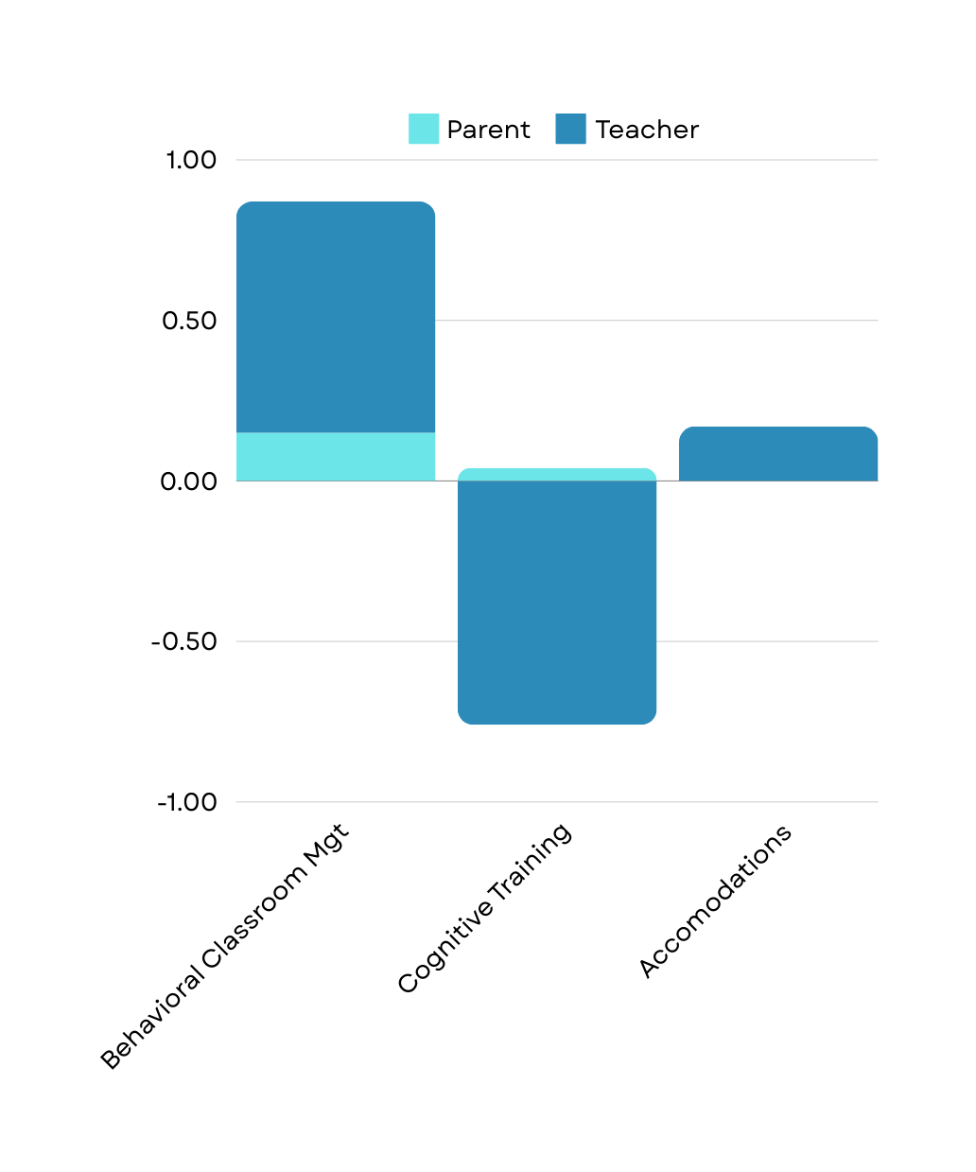
Impact on Functioning
Fabiano et al., 2021
Invest in interventions that are worth your time!

Slide 29



Clear Expectations
Labeled Praise
Effective Commands
Premack Contingencies
Transitional Warnings
Effective Instruction
TIER 1 Strategies
PBIS

Slide 30




Home-School Communication
PBIS
PARENTS ARE ESSENTIAL TO BEHAVIORAL SUCCESS!
Whether through an app like Class Dojo or Remind, or through daily or weekly notes, parents should be updated regularly about their child's behavior - and yes, even at Tier I! Some ideas for home-school communication:
  Apps with daily points, feedback, pictures
  Weekly "Good News" emails
  Weekly "Good News" letters
  Color-coded daily planner (Red, Yellow, Green)
  Home-School Communication Log

Slide 31
Daily Report Card (DRC)
A DRC is an effective tool that provides a way for daily communication between teachers and parents. It focuses on strengthening desired behaviors, while reducing the need for notes or phone calls to parents about problem behaviors.
Once in place, a DRC often reduces the amount of time that teachers spend dealing with a child's problem behaviors, allowing more time to focus on promoting learning and positive behaviors.
DRCs provide a tool for maintaining positive behaviors and monitoring of a child's progress over time.
Notes:
unlike systems often used that: focus on documenting problematic behaviors,
vaguely define behaviors, provide inconsistent feedback, focus more on punishing undesired behaviors than on
rewarding desired behaviors, and/or set goals that have to be met over the course of an entire day or week

Slide 32
Daily Report Card (DRC)
Many studies have shown that DRCs are more effective in changing the problematic classroom behaviors of a child who has ADHD than typical "charts" or "logs."
What makes a DRC effective?
Clearly defined behaviors
Use of prompts/reminders
Feedback and encouragement at regular intervals throughout the day
Goals based on performance over shorter periods of time
Notes:
unlike systems often used that: focus on documenting problematic behaviors,
vaguely define behaviors, provide inconsistent feedback, focus more on punishing undesired behaviors than on
rewarding desired behaviors, and/or set goals that have to be met over the course of an entire day or week

Slide 33
6 Steps to Establishing a DRC
Select the areas for improvement
  What are the greatest areas of impairment?
Determine how the goals will be defined
  What are specific (clearly defined, observable) behaviors that can be changed to make progress towards the goals?
Decide on 1-3 goal behaviors and criteria for the DRC
  How often is the child currently doing the goal behavior?
  What is the rating period? When can the child receive feedback about their performance?
  What is a reasonable criterion for success for each behavior during the rating period
    Maximum number of prompts/reminders in a rating period
    Good initial criterion is one the child can successfully meet at least 66-75% of the rating periods
Notes:
What behavior should the child be doing instead? Or, what is a behavior that is incompatible (cannot happen at the same time)?

Slide 34
6 Steps to Establishing a DRC
4. Explain the DRC to the child
5. Establish a reward system in school
  What rewards can the child receive for meeting goals?
  Provide the child with feedback about their performance at the end of each rating period.
6. Monitor, modify, and maintain the DRC
  When should we modify goal criteria?
    Make it harder once they meet the criterion regularly (e.g., meets goal >90% of the time for at least 5-7 consecutive school days)
    Make it easier if they regularly fail to meet criteria.
    Remove the goal when the behavior is at an acceptable level and child is consistently meeting their goal. If behavior decreases, readd the behavior to the DRC.
Notes:
What behavior should the child be doing instead? Or, what is a behavior that is incompatible (cannot happen at the same time)?

Slide 35
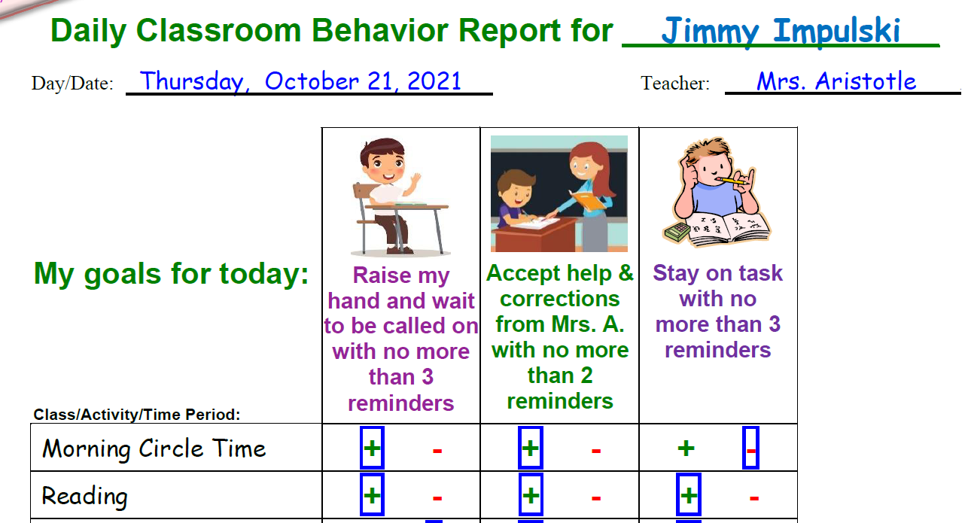

Slide 36
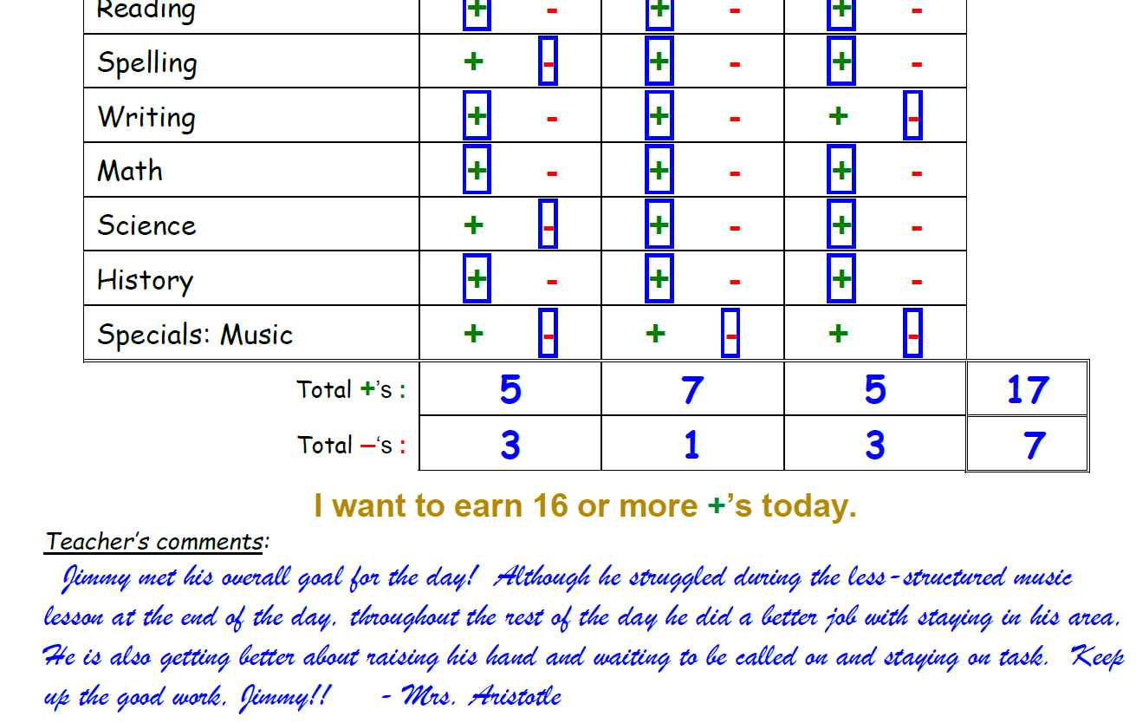

Slide 37
Case Example
Johnny is in 1st grade. He is very social and a good friend, but he often talks to his peers when the teacher is talking. He loves contributing to class but frequently blurts out answers before being called on. In addition, when faced with challenging work, Johnny often gets frustrated and rips up his worksheets.

Slide 38

Case Example
Carol is in 8th grade. She is very smart, but her grades do not reflect this because she often forgets to turn in her homework. She often comes to class unprepared without her laptop or textbooks.

Slide 39








Most Common Roadblocks
Teacher Implementation (regular feedback from teacher to child is key)
Goals are un-achievable (warning sign is all red days)
Intervals between feedback too long (child loses interval and crashes)
Rewards unattainable (too many big-ticket items)
Parents not delivering rewards at home in a timely manner

Slide 40
Have parent talk to teacher about giving feedback (bring in school psychologist or counselor)
Raise number of prompts allowed; decrease number of "Yes" needed for reward
Shorten intervals - provide feedback more frequently
Add small, daily rewards that are no or low-cost
Encourage parents to deliver rewards (frame like a paycheck for the child)
Roadblock Solutions

Slide 41

Additional Resources
Since this is short - here are ways to continue learning about ADHD and growing your toolkit:
  Coursera: ADHD Everyday Strategies for Elementary Students
  CHADD
  Positive Parenting Program

Slide 42
Center for ADHD
Assessment
  Diagnostic Evaluations (4 Stages)
Group Treatments
  Understanding and Managing ADHD Parent Group (Preschool and Elementary)
  Academic Success In Middle/High School Groups
Individual/Family Therapy
  Individual/Family Therapy
  Parent-Child Interaction Therapy (limited)
Specialty Services
  Cognitive disengagement syndrome service
  FOCALPlus Driving Training
Families can call our intake line directly to enroll (no referral needed): 513-636-4336

Slide 43






Questions!

Slide 44

Springer School and Center empowers students with dyslexia, ADHD, and executive function challenges through four pillars: Springer Diagnostic Center, Springer Lower School & Middle School, Springer High School and Springer Learning Center.
Learn more at Springer-LD.org.

