Slide 1


February 13, 2026

Slide 2
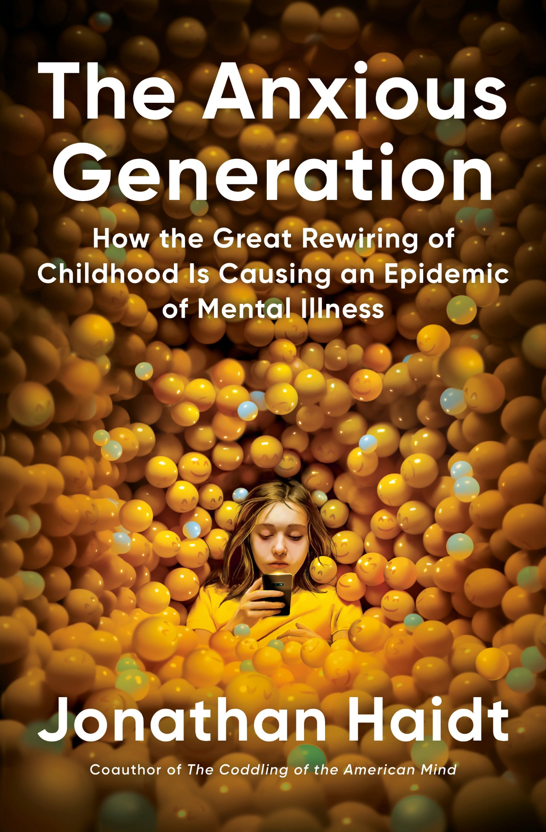
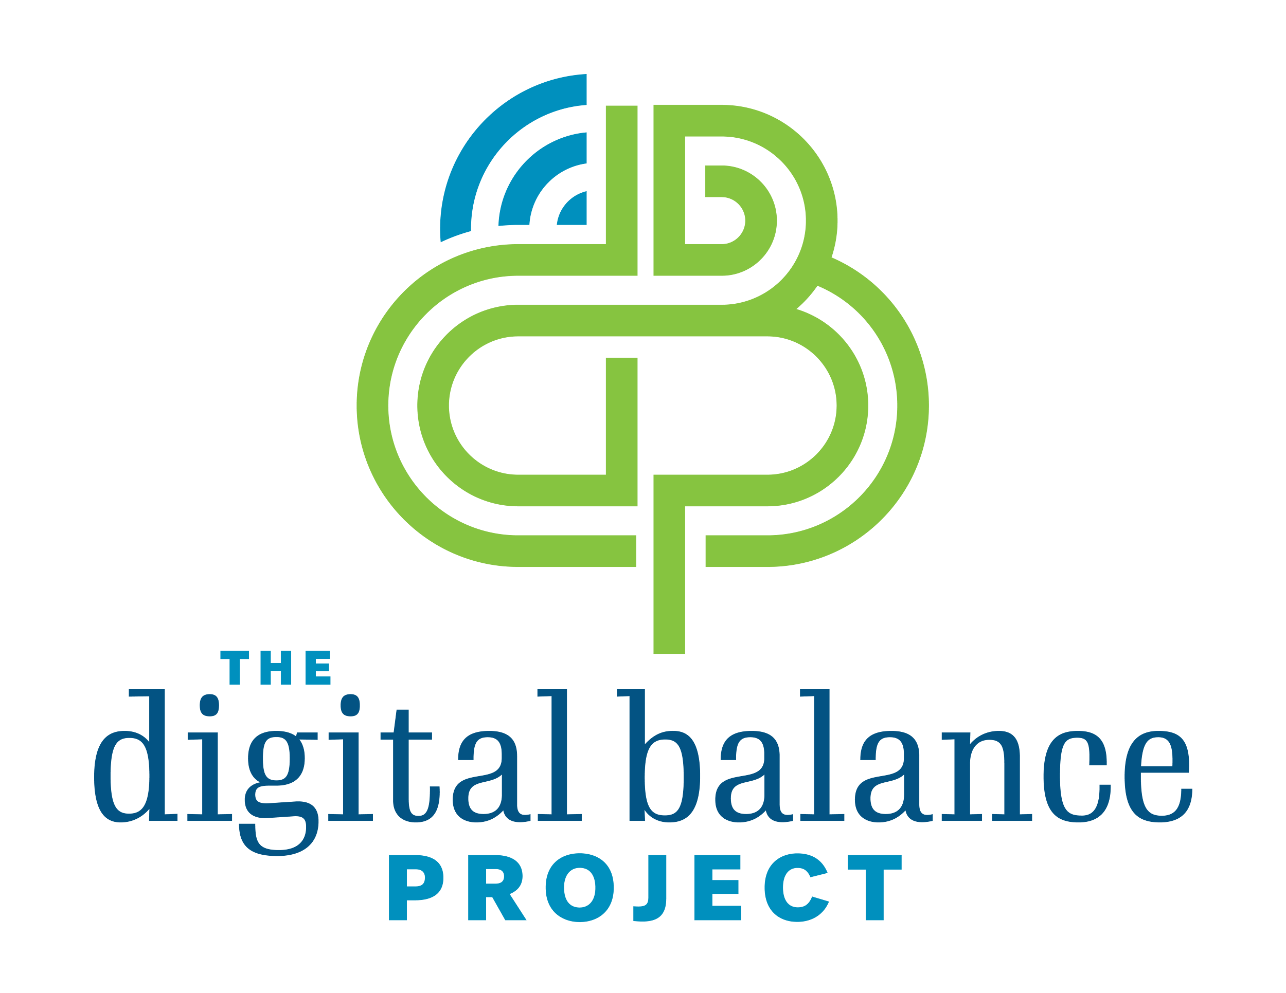
The Anxious Generation:
Key Insights and Takeaways from the Viral Book
Presented by:
Notes:
Alexis - Welcome and thank you for having us.
We are going to summarize the VIRAL The Anxious Generation.

Slide 3
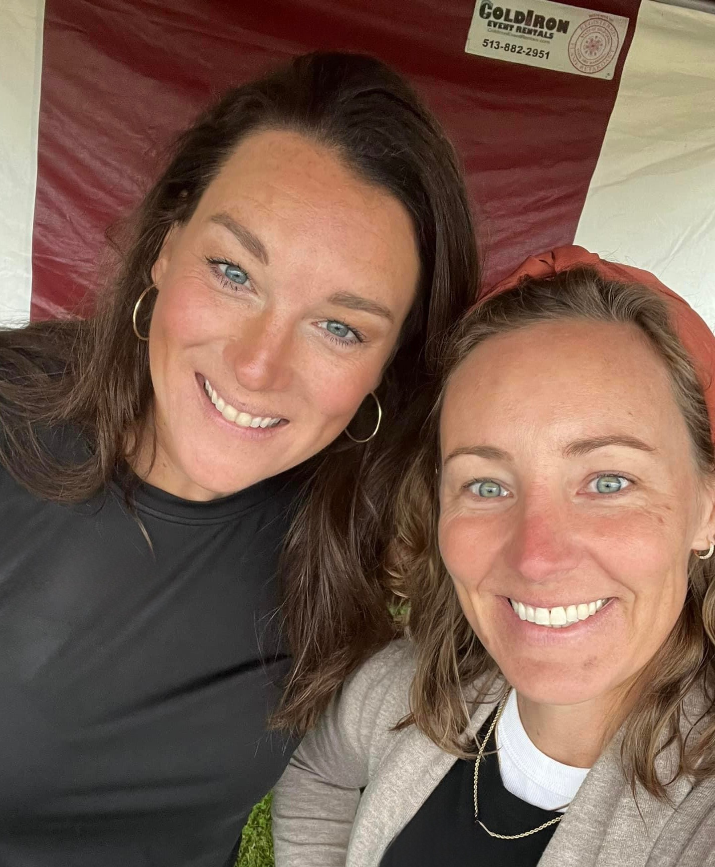
Mission Statement
To empower families and communities to cultivate healthy digital habits by delaying social media exposure until children are developmentally ready.
We are committed to educating, equipping, and supporting parents, as well as children, with the knowledge and tools needed to foster mindful technology use, enabling families to make informed choices that align with their values and well-being.
Notes:
MEGHAN - 2 min
Im meghan this is alexis and we are the cofounders of DPB - formally Osprey
PT and NP
More importantly we are 2 local Ayer moms with us both having 6th and 4th graders
We ended up putting our heads together after having several conversations between ourselves and other mom friends back when our boys were just in 1st grade
It seemed like almost everyone felt the same way… so we decided to do something about it because when we know better… we do better!
Thats when OSPREY and then DBP was born - we have recently rebranded due to the traction and support we have been receiving
With that, our mission is….
Before we get started we want to get to know you!
How many of you have children yourselves?
How many have an elementary aged child? Are in upper education?
How many are empty nesters now?
What is your population student age that you? Primary education vs intermediate vs high school

Slide 4
Objectives
“The Great Rewiring of Childhood”
A Tidal Wave of adolescent mental illness that began to rise in 2010
Transition from “Play-Based Childhoods” to “Phone-Based Childhoods”
Overprotection within the real world
Underprotection within the virtual world
Puberty = sensitive period for social/cultural learning
Differences amongst adolescent girls and boys
The need for Collective Action
Governmental level
School level
Parental level
Notes:
WHAT IS THE TAKEAWAY FOR AN EDUCATOR? Why do they care?
Alexis - Meghan and I have both read and dissected Jonathan Haidt’s Anxious Generation Book. We will go into more detail throughout the presentation but the
main idea is that between the years of 2010 and 2015, social lives of American teens and adolescents moved into smartphones which included social media, online gaming and other internet activities - he refers to this time period as “The Great Rewiring of Childhood”
where an overwhelming amount of research shows significant spikes in mental illness that all begin to rise around 2010
This is also the time period where play-based childhoods transitioned to phone-based childhoods
Another key point is that he dives into is Overprotection in the real world and under protection in the virtual world.
We also learn from the book about how puberty is a sensitive period of time that is responsible for cultural learning as well as the differences seen in adolescent girls vs. boys
Lastly, Haidt calls for a collective action approach from the community at large including: governmental, school and parental levels
These takeaways are specific for The Anxious Generation but Meghan and I want to add something when it comes to being an educator and what we hope you learn from presentation.
Children are being exposed outside of the classroom. Each educator has a perspective on these students that parents are not privy to or to see.
Be the eyes and ears that you can be. Use this information to help guide students social well-being.

Slide 5
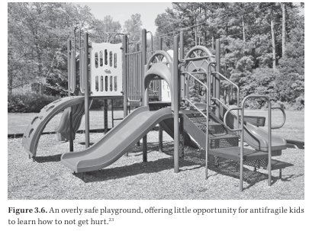
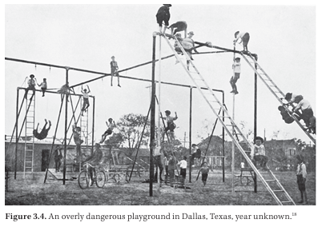
Child Development: What We Know…
Regardless of age, PLAY is key to development!
Some degree of physical risk is essential
Teaches children how to look after themselves and each other
Notes:
MEGHAN - 1 min
When we think about child development… most of us are familiar
“developmental milestones” of infancy or toddler year
Crawling, holding bottle, walking, talking, eating first solid foods
But we tend to not appreciate or recognize the adolescent milestones
Especially social-emotional ones like
Making and maintaining friendships
Recognizing personal identity traits
Developing coping skills
BUT… regardless of age…. Haidt makes a point that PLAY is absolutely key to growth and development
When kids are playing, climbing, falling and discovering in their NATURAL environments
They learn how to look after themselves and each other!
They learn nonverbal cues and relationship repair
Pictures - difference between playground we see today vs. original playgrounds

Slide 6

Overprotection in the Real World
“Stranger Danger” led to “Safetyism”
No adult could be trusted by children
The world is much safer than it was decades ago
Lower crime rates
Fewer sex offenders
Decreased number of drunk drivers
Notes:
Alexis - On the internet there NO equivalent to a PG-13 movie, or getting your driver’s license. On the internet that 13 y/o appears the exact same as the 41 year old.
The last law that was enacted by US congress regarding adolescent protection on the internet was in 1998/2000, BEFORE ALL SOCIAL MEDIA PLATFORMS EVEN EXISTED. The law considers “adulthood” to be 13 on the internet. One must be 13 in order to make an online account which saves their data information. The book uses lots of data that that would support our US congress to move this age to 16, as 13 is FAR TOO YOUNG.

Slide 7

“EXPERIENCE, not INFORMATION, is the key to emotional development. It is unsupervised, child-led play where children best learn to tolerate bruises, handle their emotions, read other children’s emotions, take turns, resolve conflicts and play fair.”
Notes:
MEGHAN - 35 seconds
Haidt explains “Experience….”
The book talks about this idea of a “psychological immune system”-
- humans grow stronger when they are challenged not just physically but mentally too
We need this mental toughness to be strong… in order to function as adults in the real world

Slide 8

Puberty
A period of rapid brain rewiring – 2nd only to the first few years of life
A time to develop adult-level real-world social skills
Haidt states we should be concerned about the experiences in which an adolescent has during this time and not let strangers and algorithms choose them
Notes:
Alexis -
Intermediate years in education are very impactful. And here’s why.
Puberty is an extremely sensitive period. It’s a period of rapid brain rewiring, which is 2nd only to the first few years of life (Where we are learning to walk and talk)
Pubescent years is also a time where adolescents develop adult-level real world social skills.
The book points out a challenge that our adolescents are having transitioning to adulthood. Teens are communicating more and more via emojis and acronyms than any previous generation and this is not helping their adult social skills.
Haidt brings up an interesting comparison of an adolescents puberty and a caterpillars puberty. A caterpillar gets to experience puberty in a chrysalis, in private and come out a beautiful butterfly. We, as humans, are not so lucky.

Slide 9

“In the real world, it often matters how old you are but as life has moved online, it matters less and less.”
“On the Internet, everyone is the same age, which is NO particular age.”
Notes:
Alexis - On the internet there NO equivalent to a PG-13 movie, or getting your driver’s license. On the internet that 13 y/o appears the exact same as the 41 year old.
The last law that was enacted by US congress regarding adolescent protection on the internet was in 1998/2000, BEFORE ALL SOCIAL MEDIA PLATFORMS EVEN EXISTED. The law considers “adulthood” to be 13 on the internet. One must be 13 in order to make an online account which saves their data information. The book uses lots of data that that would support our US congress to move this age to 16, as 13 is FAR TOO YOUNG.

Slide 10

The Great Rewiring (2010s)
Phones transformed from TOOLS → PLATFORMS
Front-facing cameras
Rapidly advancing high speed internet
Social networks changing to social platforms
Notes:
MEGHAN - 45 sec
As our digital world has quickly evolved in less than a century… so have our childhoods.
John describes this as “The Great Rewiring”
Starting around 2010….
FRONT FACING CAMERAS : making it easier to take photos and videos of yourself
HIGH SPEED INTERNET: making it easier for everyone to consume everything quickly
SOCIAL NETWORK> PLATFORMS: were we would search for validation with likes and comments rather than simply connecting with long lost friends or relatives

Slide 11
Facebook buys Instagram = 10 million followers
The Apple app store = 3000 apps
The Apple app store = 1 million apps
2009
2012
2026
2008
2011
2013
The Apple App store = 2 million apps
Facebook = 90 million followers
Facebook introduces the “like” button
Notes:
Here are some interesting events to think about in relation to Haidt referencing 2010’s
Look at in such a short amount of time the change that occurred. We had no idea at the time what an impact this would have!

Slide 12
Childhoods: Play-Based vs. Phone-Based
Millennials*
Gen Z
Play-based childhoods
Start of “Safetyism”
Discover mode
Puberty WITHOUT smartphone/social media
Phone-based childhoods
“Safetyism” grew
Defend mode
Puberty WITH smartphone/social media
VS.
*Millenials were the last generation to go through puberty without the access to smartphones
Notes:
MEGHAN - 1 min
So lets compare the two different experiences of childhood just 1 generation apart
Millennials = anyone born between 1981-1995
Generation Z: anyone born between 1996-2012
Millennials… outside (playgrounds, tree houses, capture the flag, riding bikes) - where they could “discover” by taking calculated risks
Gen Z on the other hand
They formed friendships online
They learned what was desirable from social media platforms
Higher likelihood to be stuck in “defend mode” where they are much more cautious, anxious and have a greater inability to manage conflict
Millenials were the last generation to go through puberty without the access to smartphones

Slide 13
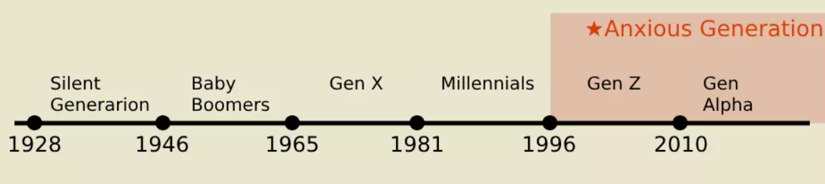
“Overprotection in the real world and underprotection in the virtual world, are the major reasons why children born after 1995 became the anxious generation”
Notes:
MEGHAN - 20 sec
Summary of entire book in 1 quote

Slide 14
Risks of Phone-Based Childhood
Notes:
ALEXIS - Haidt briefly touches on the Benefits of smartphones and social media (especially for marginalized groups).
Positive community - LGBTQ feel inclusive where they may not feel that way inside their physical community.
Access to important information.
Space for self expression
Fun & entertainment
However he concludes that the risks far outweigh the benefits in childhood - especially with an underdeveloped body and mind
How do you feel like social media and the increased use of smartphone have affected your students or behaviors you see within the classroom? Fatigue? Agitation? Behavioral outbursts?
The amount of insomnia I am treating as an NP
Meghan inside school - nudes sent (child pornography and consequences… I see it and my husband sees it on a regular basis)

Slide 15
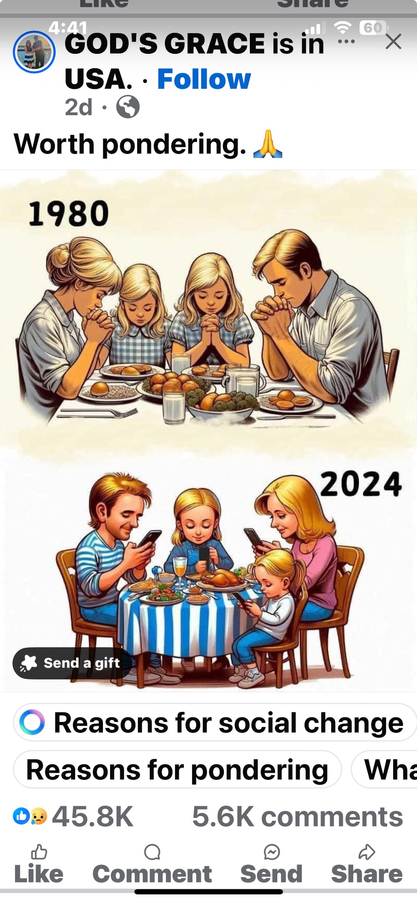
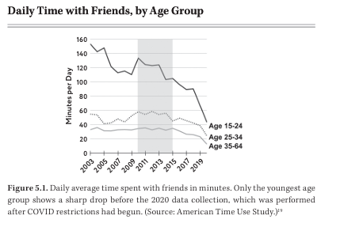
Risk # 1: Social Deprivation
Smartphones = Experience Blockers
“Safetyism” = Experience Blockers
Family sits “alone together”
Notes:
MEGHAN - 30 sec
John claims that
Both smartphones and safetyism can block us from having real life experiences
By not getting outdoors and playing
By not getting outside our comfort zones by exploring
By not engaging with one another
WE HAVE A RISK OF SOCIAL DEPRIVATION
I think some of us might relate to this picture on the right… where a family sits “Alone together”

Slide 16
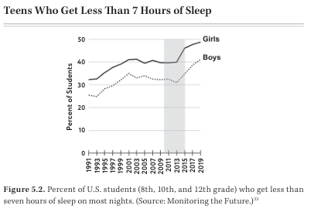

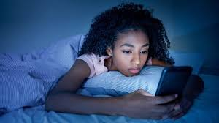
Risk # 2: Sleep Deprivation
Sleep is competing with smartphones and social media!
Sleep Needs per Night (minimum)
Preteens = 9 hours
Teens = 8 hours
Notes:
ALEXIS -
The research proves that teens are getting less sleep and even more than that the research shows that less sleep increased greatly after 2012. This research study shows 8th, 10th, 12th graders → Large increase in the # of teens who get less than 7 hrs of sleep a night starting in 2012/2013
Haidt reviews how sleep is imperative for functioning during the day and that teens and adolescents need more sleep as their bodies and brains develop through puberty
When devices are allowed in the bedroom at night it allows for use well beyond bedtime and “under the cover” use – decreasing sleep time
Real world experience as a nurse practitioner. I am treating sleep disorders and insomnia on a daily basis, AND LET’s BE HONEST, some of the time I’m treating phone addiction as that is the reason people are not able to sleep well. I’ve actually started pulling up patient’s screen time use.

Slide 17
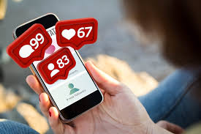
Risk #3: Attention Fragmentation
The AVERAGE # of notifications on youth phones from the top social and communications apps is 192 per day
If the AVERAGE teen gets 7 hours a sleep per day…
… which equals 11 notifications/hour, or
~ 1 notification every 5 minutes
Humans can’t truly multitask
Notes:
MEGHAN- 1 min 45 sec
It is important to note that people can’t truly multitask - at best, all we can do is shift attention back and forth between tasks while wasting a lot of it on each shift
Beyond the literal distraction,
several studies have shown… the mere presence of a phone decreases our attention and cognitive ability
Study of college students: randomly assigned into 3 groups
Leaving bag/phone in entry way of lab
Keeping phone in bag or pocket next to them
Putting phone on desk next to them
Then completed a task requiring math problems while also remembering a string of letters
Results showed the further away their device… the better their test score was.
A lot of states are now recognizing these alarming studies, including Ohio who recently passed a law in June of this year banning use of cell phones during instructional hours… but do remember they are likely right next to them in their bags!
Haidt also reports that studies have also shown… adolescence with ADHD tend to be
Heavier users of smartphones and videos games
Worsening ADHD symptoms with heavier use

Slide 18
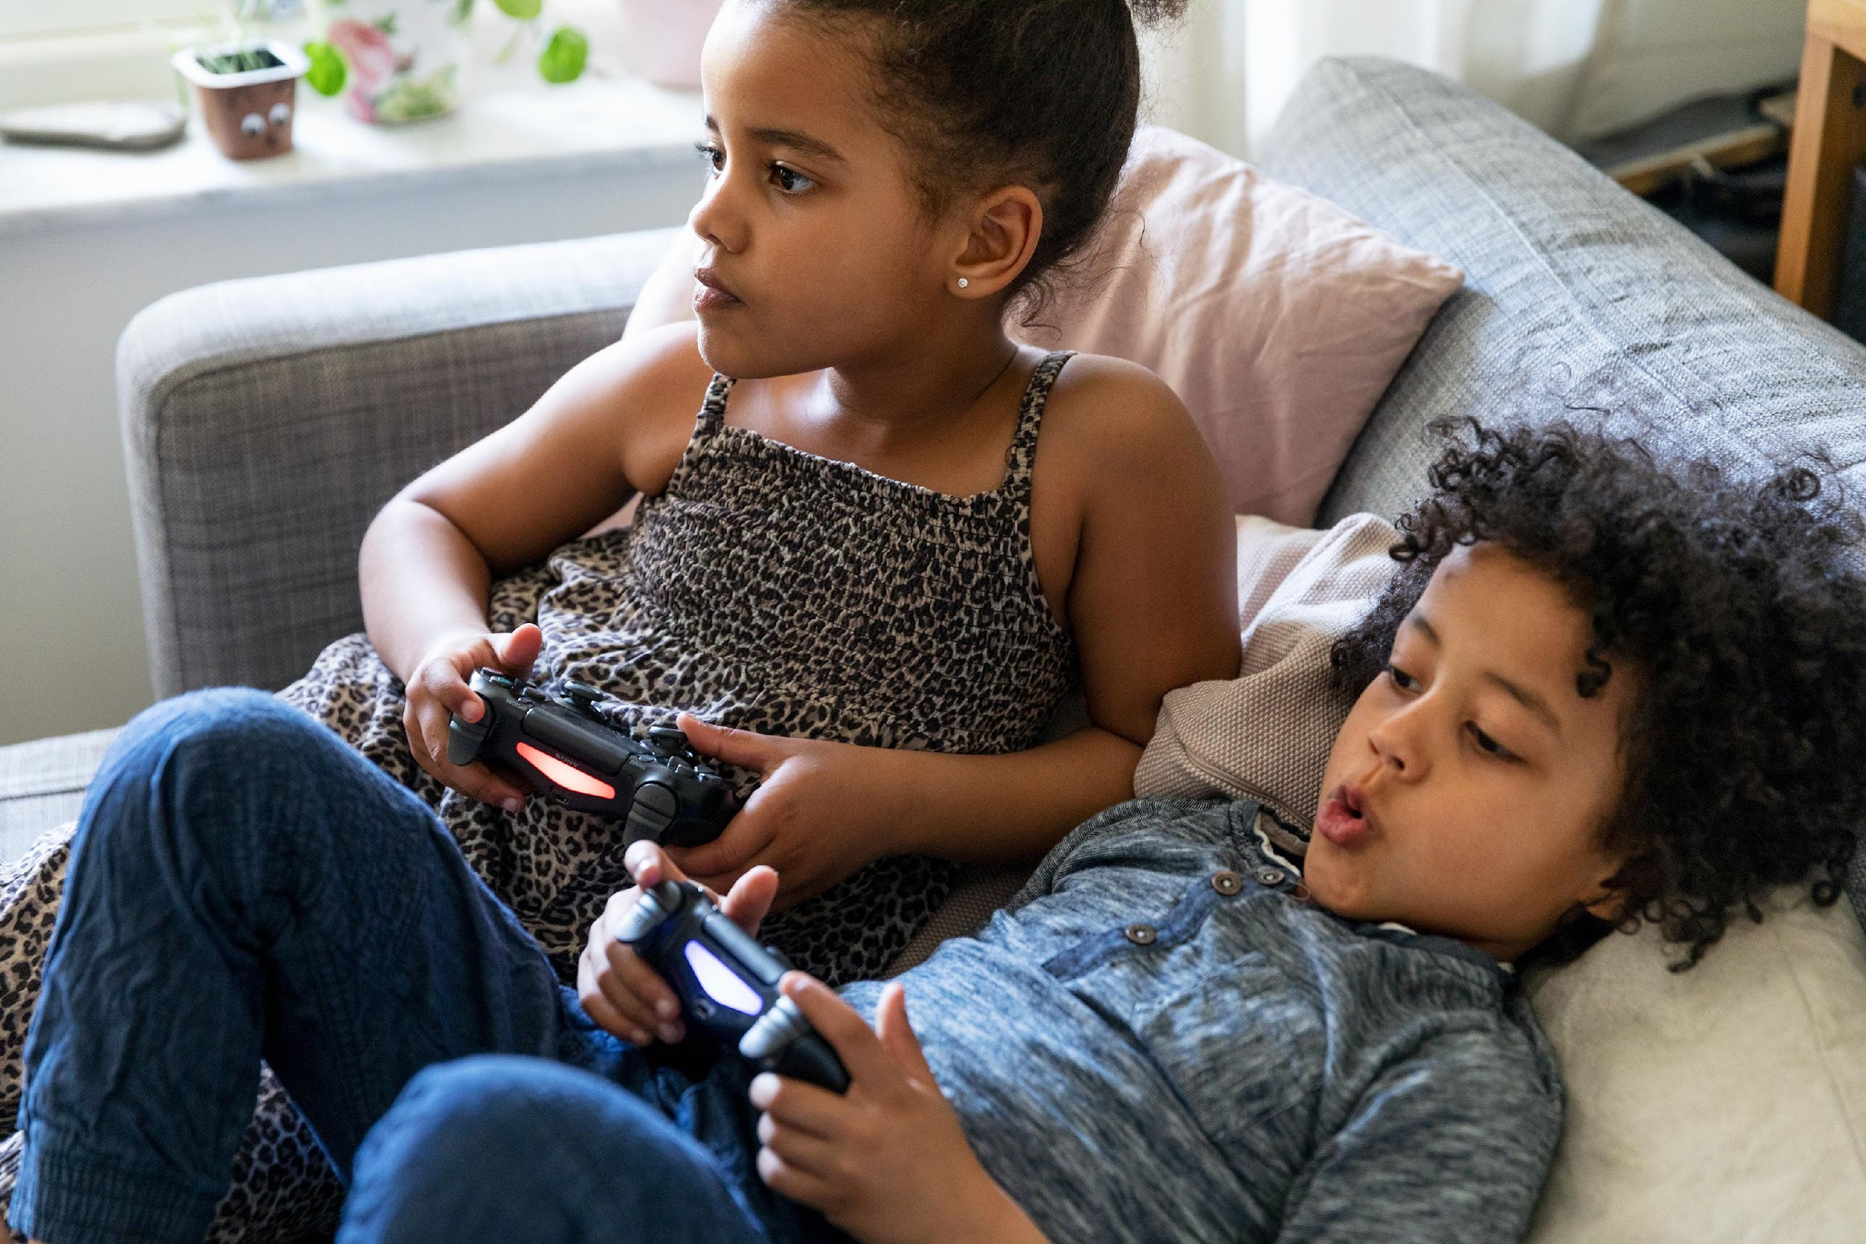
Risk # 4: Addiction
The great majority of adolescents using Instagram or playing Fortnite are not addicted, but their desires are being hacked and their actions are being manipulated
Action + Good Outcome = Neurotransmitter Dopamine → Motivates us to want more
Tech and Advertising Companies KNOW this!
Notes:
Alexis
Haidt makes a point in the book to state that a great………
I think one of the scarier pieces that the book focuses on is how the TECH and advertising companies are manipulating our children for more users, more content “likes” and they are making $ while doing it. Their goal is for our children and adolescents to open an app like SnapChat and see a “like” or a fun story and that release Dopamine which motivates us to want more! Need the HIGH.
Whistleblowers have shown evidence of this knowledge and strategy behind these platforms. Facebook Inc. meetings to “engage more youth”. - “Sculpting very deep pathways within our child’s brain

Slide 19
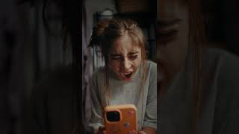
Notes:
Meghan - 1 min
Here is a really awesome ad that was recently aired for an athleisure company that gives a great visual to everything we just discussed!.....Play video
https://www.youtube.com/watch?v=5eGc6DidrD8

Slide 20
Social Media and Depression
Does depression drive social media use or does social media use drive depression?
1 person in a group of friends abstained from social media for 1 month =
even though this person felt more socially isolated, their mental health STILL improved
A random group of college students reduced social media use for 3 weeks = Significant reduction in loneliness and depression
Teen girls exposed to Instagram selfies were shown either in an original form of photo or a form modified by experimenters to be more attractive =
modified photos directly lead to lower body image for these teen girls
Social media use can cause depression!
Notes:
Alexis
A question I was asking myself while reading this book was “DOES DEPRESSION DRIVE SOCIAL MEDIA use or does social media use drive depression?”
There are 3 studies that I think you all should know about.
Teen girls exposed to Instagram selfies were shown either in an original form of photo or a form modified by experimenters to be more attractive =
modified photos directly lead to lower body image for these teen girls
A random group of college students reduced social media use for 3 weeks = Significant reduction in loneliness and depressin

Slide 21
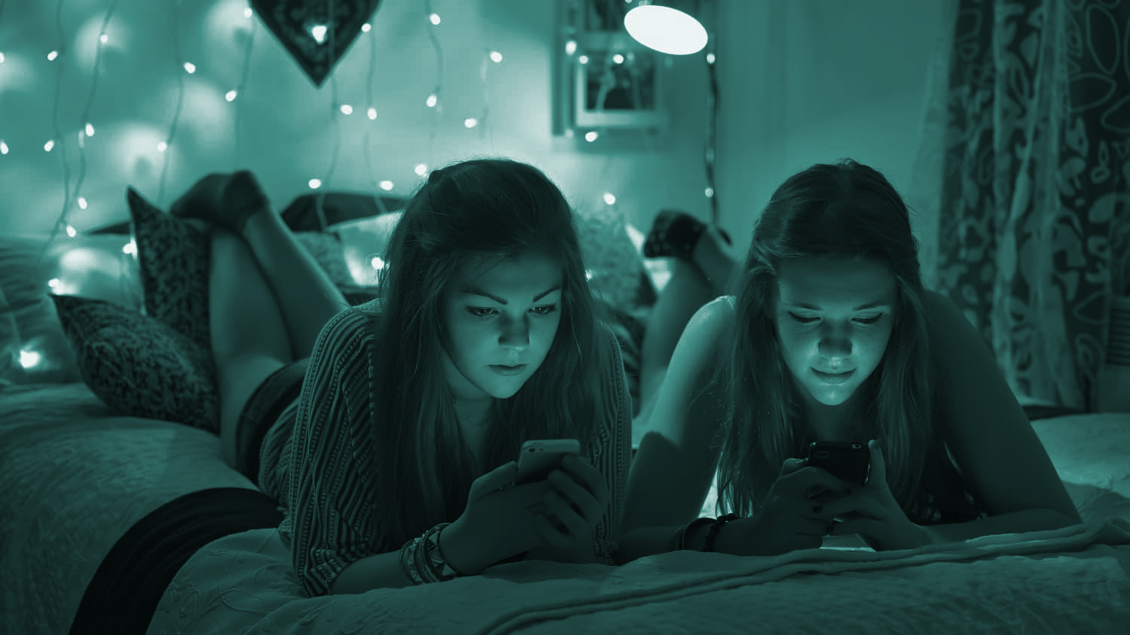
GIRLS
Social media is more harmful to girls
More affected by visual comparison and perfectionism
Aggression is more relational
Share emotions and disorders more easily
Most subject to predation and harassment
Notes:
The book divides GIRLS and BOYS
Alexis
After you read this book, it is SO CLEAR how harmful social media is to girls
This graph shows that the more time a girl uses social media, the more depressed they are.
More affected by visual comparison –
social media algorithms hone in on girls’ desires to be beautiful.
A study was done where they made 12 accounts on TikTok for 13 year old girls → Served tens of thousands of weight-loss videos within a few weeks
Another reason girls are more vulnerable is they share emotions and disorders more easily than boys.
Research found that happiness and depression spread within friendship networks, HOWEVER bad was found to be stronger than good.
So that means that Depression is significantly more contagious than happiness.
Even more than that, what was interesting is that girls depression spread to girls and boys (increasing their odds of depression) however BOYS who were depressed had no measurable effect on their friends, as they are not as openly sharing their emotions within their friend groups.

Slide 22
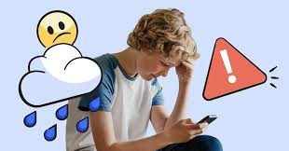
Boys Are More Complicated Than Girls
Shifting to internalizing disorders
Need more studies to evaluate pornographic impact
Did NOT find clear evidence that supports a blanket warning to boys and video games
Studies are unable to point to one single technology as boys’ primary cause of distress
Notes:
Alexis -
Boys have a different path through the “great rewiring”
Haidt believes that boys’ distress is connected to technology as the #s have increased since 2010 overall, but is not connected to one SINGLE technology, video games, pornography, or social media.
Haidt notes that depression has been rising since the 2010s just not as much as girls’ depression.
There is also the note of Safetyism and that boys are being overprotected and therefore taking less risk which is needed for healthy child development.
Alexis
For decades and decades boys and girls have exhibited distinct patterns in their mental health challenges.
Boys have higher rates of externalizing disorders (drunk driving, drug abuse, violence) and girls have higher rates of internalizing disorders (depression, OCD, anxiety).
What has happened since 2010s, BOTH SEXES have shifted rapidly towards internalizing disorders.
On the right graph you will see that boys are not just changing how they talk or think about risk, they are truly taking fewer risks. Rate of hospital admissions for unintentional injury is down.
Boys have infinite supply of high-quality videos showing every conceivable act, body part and fetish, in private
Need for more studies regarding porn and its impact on boys
“I’m not saying that all pornography is harmful; I’m saying that immersing boys in an infinite playlist of hardcore porn videos during the sensitive period in which the sexual centers of their brains are being rewired is maybe not so good.” - Haidt
Haidt thought he would find the same connection that girls have with social media and anxiety / depression as boys with video games. HOWEVER
He does note that research found 30 minutes a day, 3 days a week showed a decrease in depression symptoms.
He also talks about “heavy users” suffer more from loneliness and opportunity cost.
Boys that seek friendships via video games show more signs of loneliness so even though there are various “social gaming networks” this not appropriate for building relationships which is important for child development. They are unable to judge body language or even turn taking.
Boys must go out into the real-world for friendship.

Slide 23
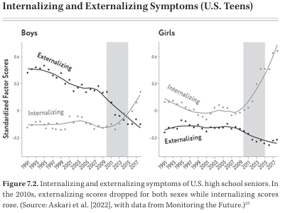
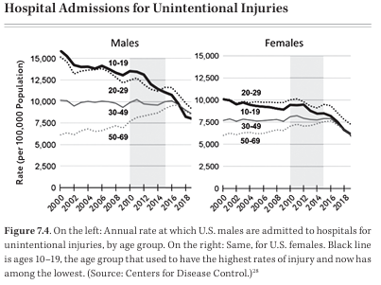
Boys Shift to Internalizing Disorders
Notes:
On the right graph you will see that boys are not just changing how they talk or think about risk, they are truly taking fewer risks. Rate of hospital admissions for unintentional injury is down.
Haidt argues that because boys are spending more time indoors, they are not out in the real-world taking risks.

Slide 24

https://www.instagram.com/reel/DTam70-jsLr/?igsh=M3dlajlhdnZ2dTVm
Notes:
It is important as an educator to be aware of the unique opportunity to listen and see the social norms that are occurring outside of the home. Parents don’t get to hear about what is trending with peers.
https://www.instagram.com/reel/DTam70-jsLr/?igsh=M3dlajlhdnZ2dTVm

Slide 25

Collective Action
Notes:
Meghan: 1 min 20 sec
Ok… so now what?
Alexis, myself, Dr. Haidt and I’m sure some of you are tired of hearing
“its too late.. Theres no going back”
The entire last portion of the book calls for collective action.
Here is what Dr. Haidt recommends…
Clip from Dr. Haidt - 51 seconds
https://www.instagram.com/reel/C53jtnjIG96/?igsh=MWdnZ2xndDBzcmFjcw==

Slide 26
Dr. Haidt’s Call for Collective Action:
No Smartphones Before High School
No Social Media Until 16
Phone-Free Schools
More Free Play
Notes:
Alexis -
Now we have heard the ACTION plan that is recommended by Haidt.
We’d like to take the time we have left to have good, thoughtful, open conversation about collective action.

Slide 27
We are NOT the gatekeepers of access. We ARE the architects of experience!
As educators….
Notes:
Ultimately, access to smartphones and social media is parent-led…
Given that many students have been given early access , what kind of nervous system are we cultivating inside our classrooms?
Build environments where students don’t need the phone as an emotional regulator

Slide 28
No Smartphones Before High School
Do you believe we have built school systems that assume 24/7 digital access?
Clubs? Group chats? Email access? Homework? Communication? Grades?
Do you notice behaviors that we have normalized that might actually be symptoms of constant digital stimulation?
Notes:
Alexis -
Now we have heard the ACTION plan that is recommended by Haidt.
We would like to have some inspiring, small group conversations on each ACTION topic.
Are there sports team apps, club apps, group texts with reminders or change in schedules?
https://www.google.com/search?client=safari&sca_esv=ef407e8802b07e7e&rls=en&q=CBS+news+flip+phone+clip&udm=7&fbs=ABzOT_CWdhQLP1FcmU5B0fn3xuWpA-dk4wpBWOGsoR7DG5zJBsxayPSIAqObp_AgjkUGqemmTG2DFZE7tmKcXVp5H8R-V4YHYjALBdV_9Tsa56rtMqnTkZmITEOeYCNMgOwkroEdiGRe56XnPJ0j7KLO63Ic9VNtQsVwTx2vooEzoqrv1JIXqcfF1hKS7g_ghDIPCVcJfts3xhln-qWnqYetpATcHULnlQ&sa=X&ved=2ahUKEwi6ieKM9NeLAxVCL1kFHZyNLZIQtKgLegQIERAB&biw=948&bih=816&dpr=2#fpstate=ive&vld=cid:a9df2af2,vid:ZFistCMZtAk,st:0

Slide 29
No Social Media Until 16
(Instagram, YouTube, SnapChat, Facebook, TikTok, Reddit)
Do your students have access to YouTube/TikTok/SnapChat during school hours on school issued devices?
How can your school improve and/or monitor this access?
If puberty is a sensitive window for social learning, what social experiences are we intentionally designing inside school?
Do you provide a lesson around safe-tech with the students you impact? Is it sufficient? Do you think it needs to improve?

Slide 30
Phone-Free Schools
Effective January 1, 2026, Ohio law (HB 250) requires all public schools to adopt policies that prohibit student cell phone usage during the instructional day to reduce distractions. Policies must limit phone use, though exceptions exist for health, emergency, or IEP/504 needs, aiming to boost student focus and social interaction.
Before this policy was implemented: what problems do you think they were trying to solve?
Phones have “disappeared” from schools, what barriers still exist to student engagement and access to learning?
Let's discuss what positive changes that you have observed because of the new policy.
Notes:
No app should have notifications pop up or airplane mode
Attention? Anxiety? Social comparison? Classroom management? Parent pressure?

Slide 31
More Free Play
When, during the school day, do students experience unstructured face-to-face social time - without adult direction?
Do you feel your device time within the classroom is appropriate or needs to improve?
What message do we send when we remove recess or free time as a consequence?
Are we withholding what a dysregulated brain actually needs? (think about your highest-conflict student)
Would more unstructured movement and peer interaction help or hurt them?
What evidence do you have?
Notes:
Should devices be an option as “free-choice” during indoor recess or once work is completed?

Slide 32


Resources
anxiousgeneration.com
Follow us on Facebook at:
The Digital Balance Project
thedigitalbalanceproject.com
Notes:
MEGHAN:
Thank you all for coming! - 30 sec
If you are interested in continuing to follow The Digital Balance Project - we have a facebook page were you can stay up to date with current offerings as well as a newly developed website! Jonathan Haidt also has some great resources available on his website the anxiousgeneration.com

Slide 33
References
Primary Source
Haidt, J. (2024). The Anxious Generation: How the Great Rewiring of Childhood Is Causing an Epidemic of Mental Illness. Penguin Press.
Research on Social Media, Mental Health, and Adolescence
Twenge, J. M., Joiner, T. E., Rogers, M. L., & Martin, G. N. (2018). Increases in depressive symptoms, suicide-related outcomes, and suicide rates among U.S. adolescents after 2010 and links to increased new media screen time. Clinical Psychological Science, 6(1), 3–17.
Orben, A., & Przybylski, A. K. (2019). The association between adolescent well-being and digital technology use. Nature Human Behaviour, 3, 173–182.
Hunt, M. G., Marx, R., Lipson, C., & Young, J. (2018). No more FOMO: Limiting social media decreases loneliness and depression. Journal of Social and Clinical Psychology, 37(10), 751–768.
Odgers, C. L., & Jensen, M. R. (2020). Annual research review: Adolescent mental health in the digital age. Journal of Child Psychology and Psychiatry, 61(3), 336–348.

Slide 34
References
Child Development and Play
Gray, P. (2011). The decline of play and the rise of psychopathology in children and adolescents. American Journal of Play, 3(4), 443–463.
Ginsburg, K. R. (2007). The importance of play in promoting healthy child development and maintaining strong parent-child bonds. Pediatrics, 119(1), 182–191.
Sleep and Technology
Owens, J. A., Adolescent Sleep Working Group, & Committee on Adolescence. (2014). Insufficient sleep in adolescents: Causes and consequences. Pediatrics, 134(3), e921–e932.
Body Image and Social Media
Fardouly, J., & Vartanian, L. R. (2016). Social media and body image concerns. Current Opinion in Psychology, 9, 1–5.

Slide 35
References
Web Resources
@alterikmiller, @beautyinthebeast2025 and @amyschumer. 2025, November 20. Alterik MIller tells us about the traumatic experience of finding his son unconscious and lifeless. Instagram. https://www.instagram.com/reel/DTam70-jsLr/?igsh=M3dlajlhdnZ2dTVm
@parentprotech and @jonathanhaidt. 2024, April 17. How can we protect our kids from the dangers of technology? Instagram. https://www.instagram.com/reel/C53jtnjIG96/?igsh=MWdnZ2xndDBzcmFjcw%3D%3D
Centers for Disease Control and Prevention (CDC). (2023). Youth risk behavior surveillance system. https://www.cdc.gov
Common Sense Media. (2023). The Common Sense census: Media use by tweens and teens. https://www.commonsensemedia.org
“How much life is consumed by your phone?” (n.d.). YouTube Shorts. Retrieved from YouTube.

Slide 36

Springer School and Center empowers students with dyslexia, ADHD, and executive function challenges through four pillars: Springer Diagnostic Center, Springer Lower School & Middle School, Springer High School and Springer Learning Center.
Learn more at Springer-LD.org.

