Slide 1


February 13, 2026

Slide 2

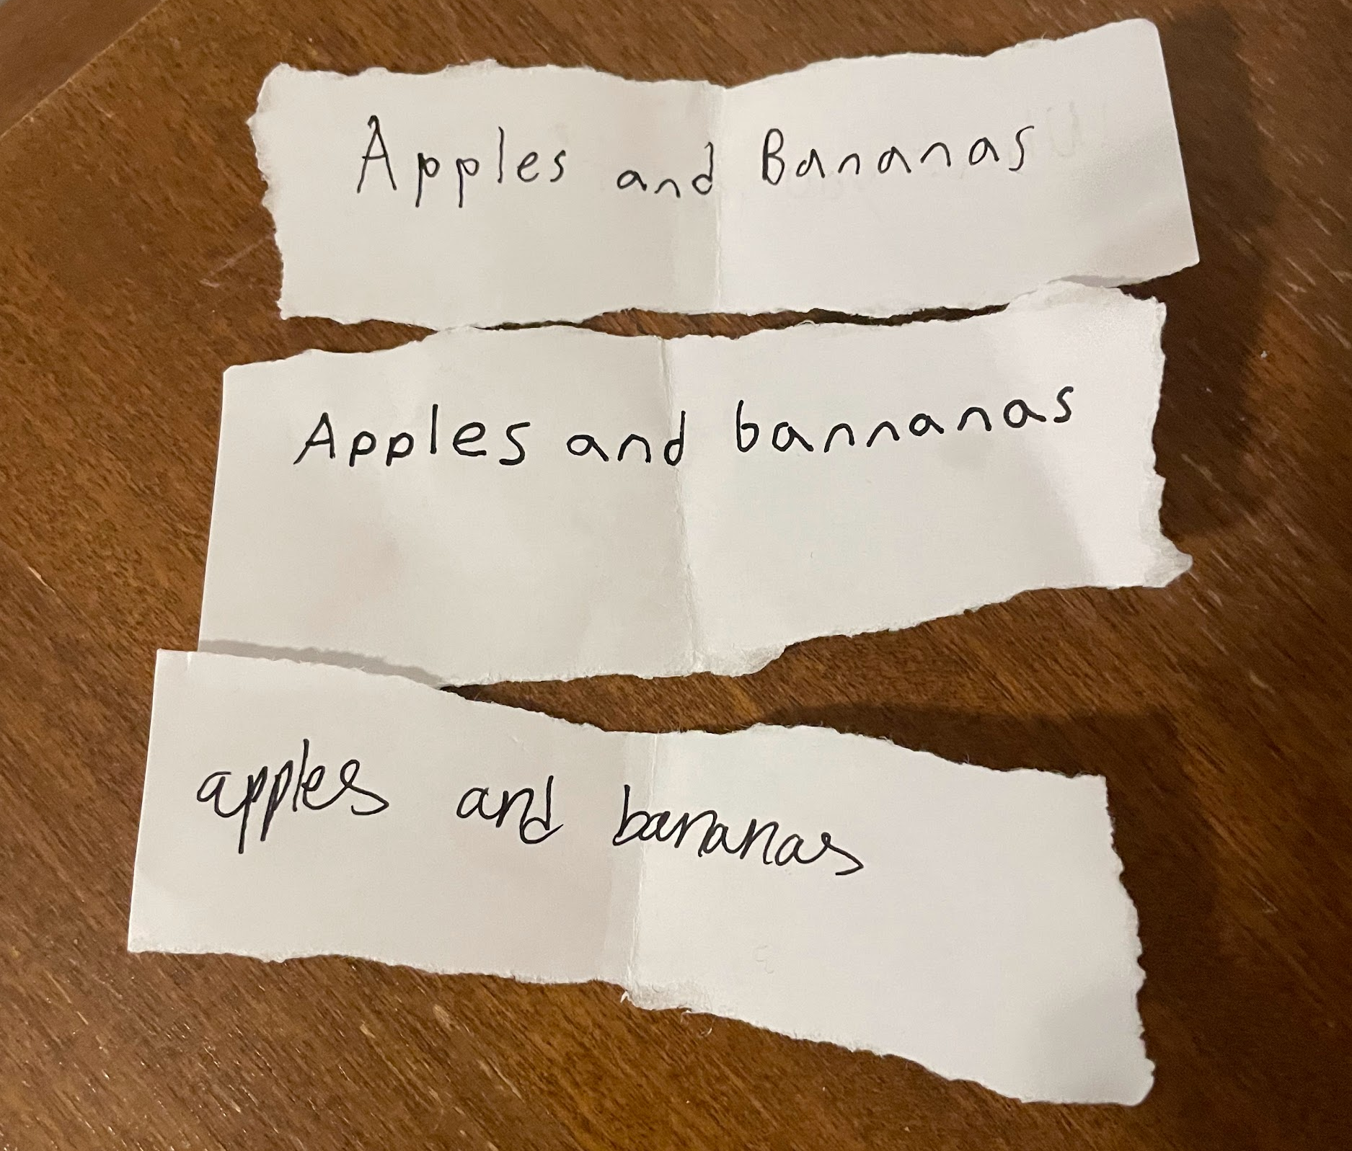
Think/Pair/Share
Which handwriting
is neatest?
Notes:
Any ideas what this question has to do with Executive Function skills? We use working memory when writing and communicating. Can you find the student who’s wm failed them because they were focused on writing neatly?

Slide 3



Our Executive Function (Goal-Directed) Categories…
for this session anyway
Working Memory
Inhibitory Control
Cognitive Flexibility
Notes:
WM- ability to hold info in mind and use it. Inhibitory control- ability to resist temptations and distractions, pause before acting. CF- ability to switch gears and adjust as things change.
This is best illustrated by a quick story.

Slide 4
Enter our Math Classroom
Station 1: computer logged in as DC, google form, paper and pencil
Station 2: The same 18 problems on a worksheet with space, pencil, highlighters, and fidget nearby.
Station 3: Paper that lists the problem numbers, lined paper, pencil, book
Station 4: book, and same as station 3, but with grids for work, not lined paper, candy
Station 5: Adaptations paper with the book, problems circled for completion, stickers and highlighters.
Station 6: same as station 2, but no fidgets and strategy pages that might help
Station 7: Regular WP copied straight from workbook

Slide 5

Goal: Experience 6th grade level math classwork
Get Ready Working backwards, what do I need to GET READY? | Do Working backwards, what do I need to DO? | Done What does this look like when it is DONE?
Learn which station you are assigned. All stations have the same problems. Notice what tools you have to use. Learn your role: Note-taker Helper Solver | Correctly solve as many of the problems that you can in 8 minutes. After solving, or after 8 minutes, confer with your group about what EF skills were needed for success. | Completed math problems with a reflection about the Executive Functions that were most needed.
Notes:
https://docs.google.com/forms/d/e/1FAIpQLSckXPXpozEtkc8yGnIFYGbfd7VSkix5JIrwKK5HDHsQnHNoVQ/viewform?usp=header

Slide 6
Reflection
How was your experience?
What working memory was needed for your task?
What impulse control was needed?
What cognitive flexibility was needed?
Notes:
Impulse Control: eliminate distractions, maintain classroom structure/routine, clear and explicit rules about calculator use and showing work, good culture
Working Memory: strategies versus reference pages, continued fluency practice
Cognitive Flexibility: discussions about math, talking about a test before taking it, visual warm ups with lots of correct answers.

Slide 7
What are strategies to promote mathematical success while simultaneously supporting and growing Executive Function skills?
Impulse Control: eliminate distractions, maintain classroom structure/routine, clear and explicit rules about calculator use and showing work, positive culture
Working Memory: strategies versus reference pages, continued fluency practice
Cognitive Flexibility: discussions about math, talking about a test before taking it, visual warm ups with lots of correct answers, Barriers and Strategies Protocol

Slide 8
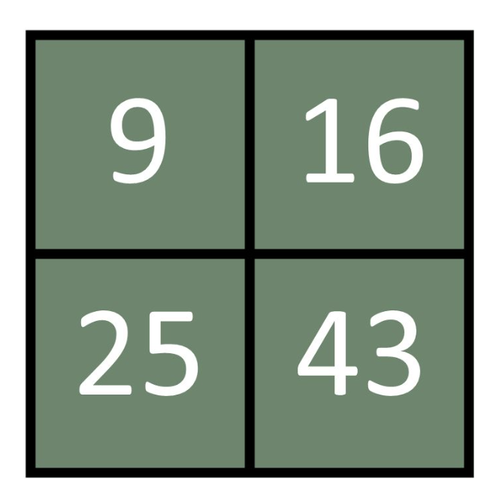
Which one doesn’t belong and why?
Cognitive Flexibility

Slide 9
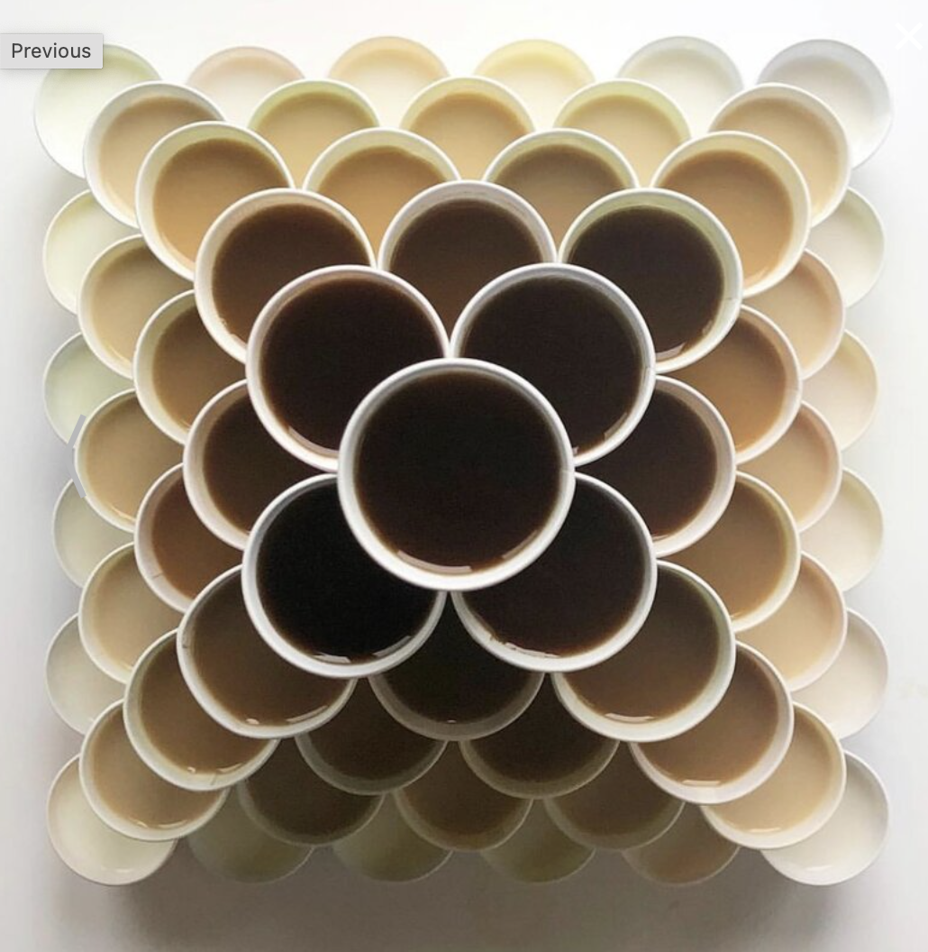
How Many?
Cognitive Flexibility
Impulse Control

Slide 10
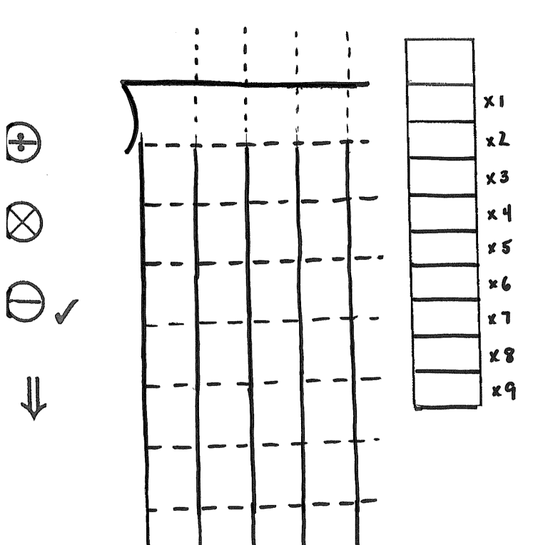
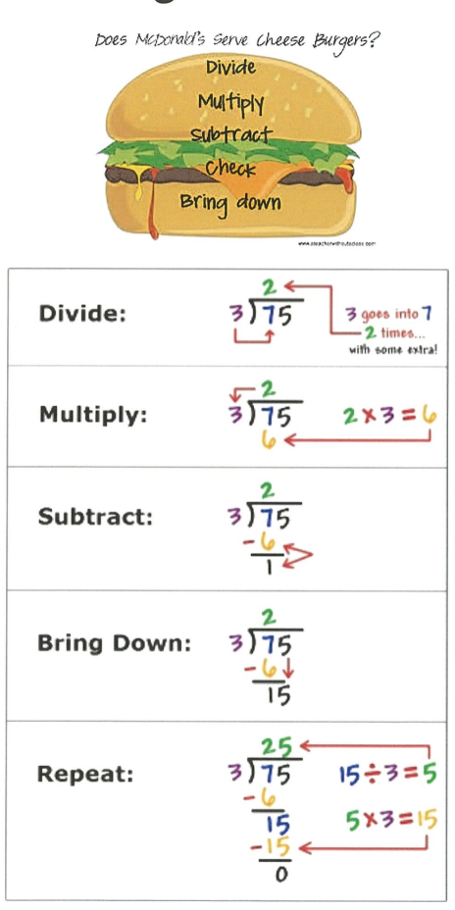
Working Memory

Slide 11
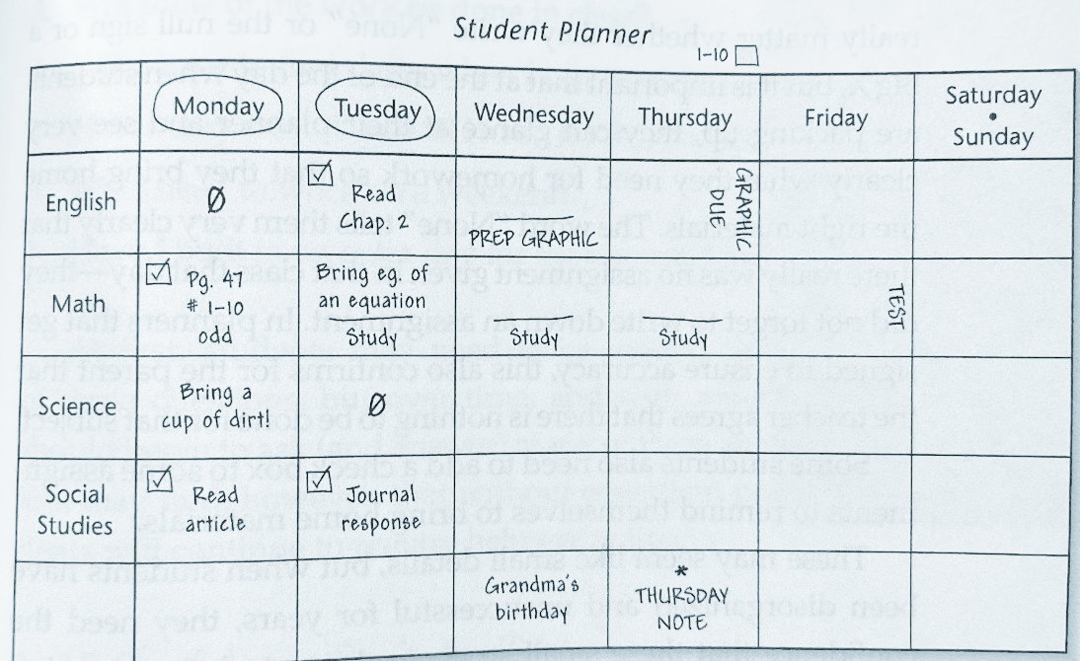
Long Term Projects and Tests entered sideways
Impulse Control

Slide 12
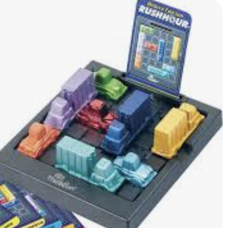
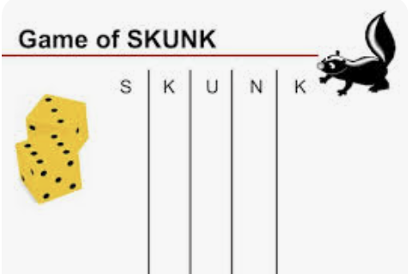
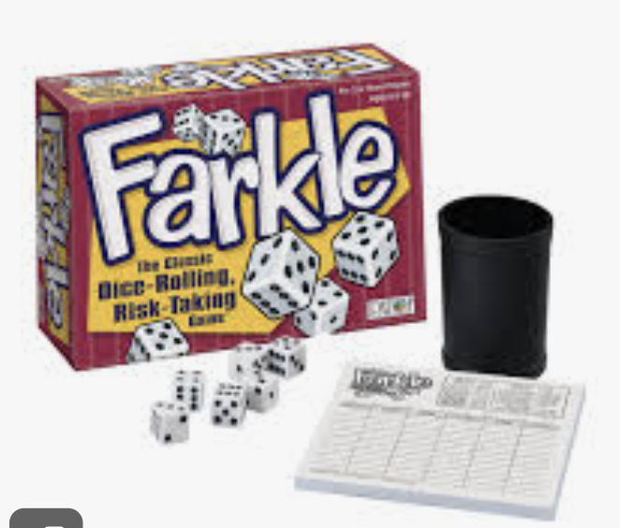
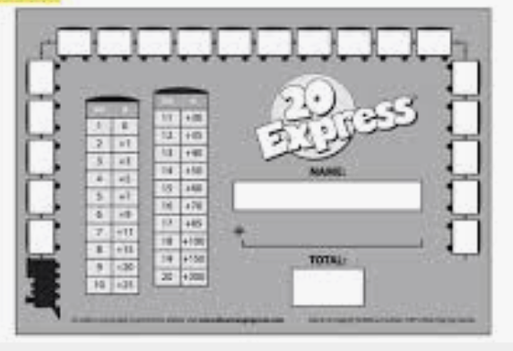
Games!
Impulse Control
Working Memory
Cognitive Flexibility

Slide 13
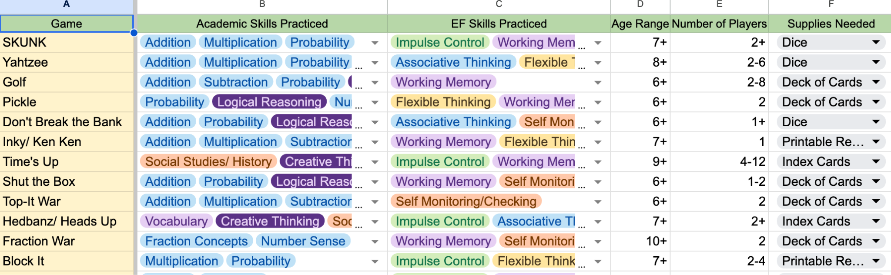
Door Prize for Everyone

Slide 14
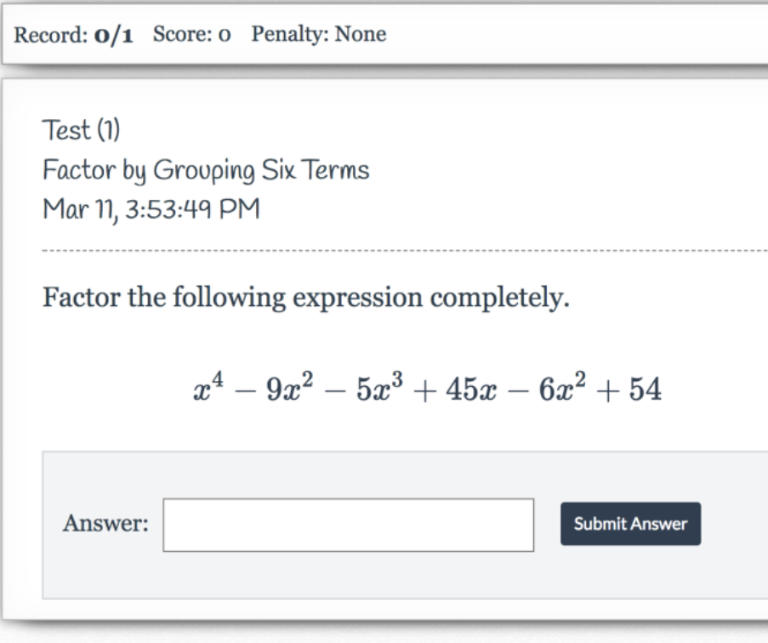
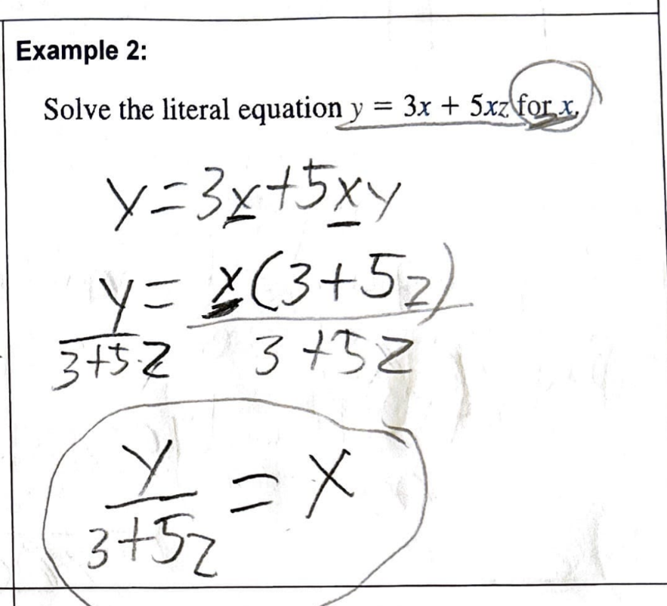
Showing Work/Paper Assignments vs Computer Assignments

Slide 15
Barriers and Strategies Protocol
Think back to our math stations.
Goal
Solve 18 problems in 8 minutes
Barriers
Distractions Shifting focus from paper to book Time pressure Not enough space to write and show work Lack of math understanding Unfamiliar set up Working with peers
Strategies
Remove distractions Advocate for supports or strategies Ask for time extension Choose to work with others or alone Consistent structure of assignments

Slide 16
Questions?
Goal
Implement more EF supports in your work with students Warm Ups Planbook Games Strategy Pages Showing Work Barriers and Strategies Protocol
Barriers
Admin support Knowing where to start Time Money Parent/Student Buy-In
Strategies
Invite Springer to your school Advocate for the supports you need Start small Explore the free options Show success stories

Slide 17


References
Which One Doesn’t Belong
https://talkingmathwithkids.com/wodb/
How Many? Number Talks
https://ntimages.weebly.com/photos.html
Marilyn Zecher: Multisensory Math
https://multisensorymath.online/

Slide 18

Springer School and Center empowers students with dyslexia, ADHD, and executive function challenges through four pillars: Springer Diagnostic Center, Springer Lower School & Middle School, Springer High School and Springer Learning Center.
Learn more at Springer-LD.org.

