Slide 1


February 13, 2026

Slide 2

Finding Function: timeline, tools and treatment to optimize EF in youth
Tracy S. Cummings, MD
Chief of Child/Adol Psychiatry, Lindner Center of Hope

Slide 3
Objectives
Highlight developmental milestones of executive functioning
Discuss tools for assessing and addressing executive functioning across settings
Explore individualized treatment strategies that support meaningful, functional outcomes

Slide 4
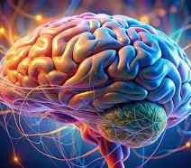
Brain Development

Slide 5
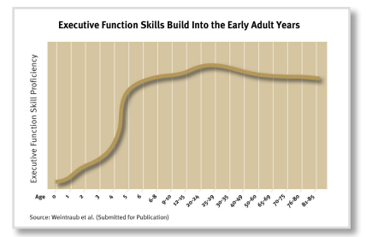
Executive Functioning Development
Working memory
Cognitive flexibility
Inhibition control
www.developingchild.Harvard.edu
Notes:
Set of skills or processes that help one make and carry out goals. EF is used for problem solving, making plans and managing emotions. Research suggests strong EFS make a difference in health and quality of life.
Air traffic control

Slide 6
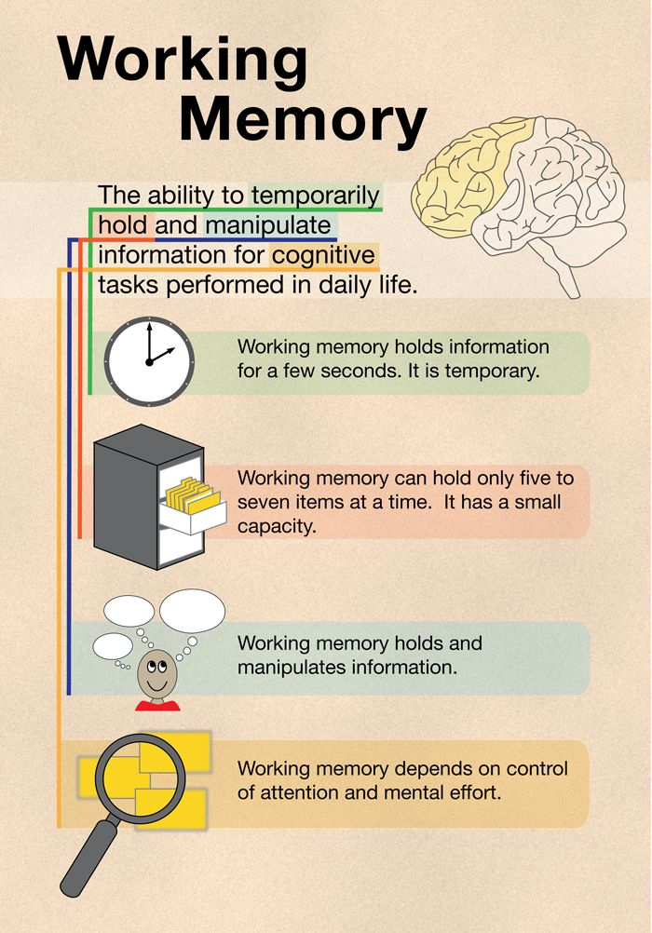
Working Memory
Develops during childhood and adolescence
Peaks in 30s
Notes:
The frontal lobe in your brain manages executive function. While anything that affects your brain tissue can affect your frontal lobe and your executive function skills, some neurodevelopmental (brain development-related) conditions specifically involve frontal lobe effects and symptoms.
It is crucial for various mental tasks, such as reasoning, problem-solving, and comprehension. Unlike short-term memory, which primarily focuses on the storage of information, working memory actively engages with the information, enabling users to process and utilize it effectively.
Nature pinpoints interactions between the frontal part of the brain that controls cognition—the mental actions involved in thinking, planning, and sustained focus—and the hippocampus, a structure nestled deep inside the brain and critical for memory formation and storage. Brain waves passing between the two regions trigger a group of brain cells called phase-amplitude coupling (PAC) neurons that help coordinate working memory. (Psychology Today, 2024)
A breakdown in either the temporary storage of information as memory or the cognitive control to retrieve and foreground the information long enough to complete a set task risks interrupting working memory. If a filing cabinet does not contain the desired document, there is no way of proceeding. Similarly, if the cabinet is in a state of complete clutter, with many other documents floating around, it will be hard to find the one that’s needed.

Slide 7
Infants/Toddler Preschool Elementary(6-11) Adolescence (12-18) Young adult (18-25)
*small amounts of information held initially
*older infants and toddlers start to anticipate repeated actions
*patterns become more apparent for toddlers
*Preschoolers can keep 3 pieces of info in mind
*Kinders have expanded working memory and use self-talk/inner dialogue to remember info
*School age working memory grows further until matches that of adults

Slide 8
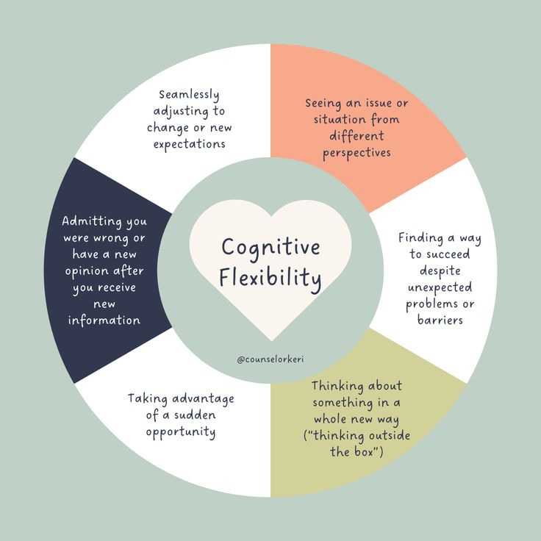
Cognitive Flexibility
Develops from ages 3-12
Improvement continues until late 20s
Notes:
Cognitive flexibility, often referred to as mental flexibility or cognitive shifting, is a crucial executive function that enables individuals to adjust their thoughts and actions based on new information or changing environmental demands.

Slide 9
Infants/Toddler Preschool Elementary(6-11) Adolescence (12-18) Young adult (18-25)
*Babies can quickly shift focus= simple needs
*Toddlers have ability to categorize objects in more than 1 way
*Flexibility increased in preschoolers with ability to do the opposite of what’s asked coming later. Around age 3, skills vary depending upon emotional state
*Kinders start to think about their feelings/beliefs and those of others
*School age youth are skilled at switching between rule sets

Slide 10
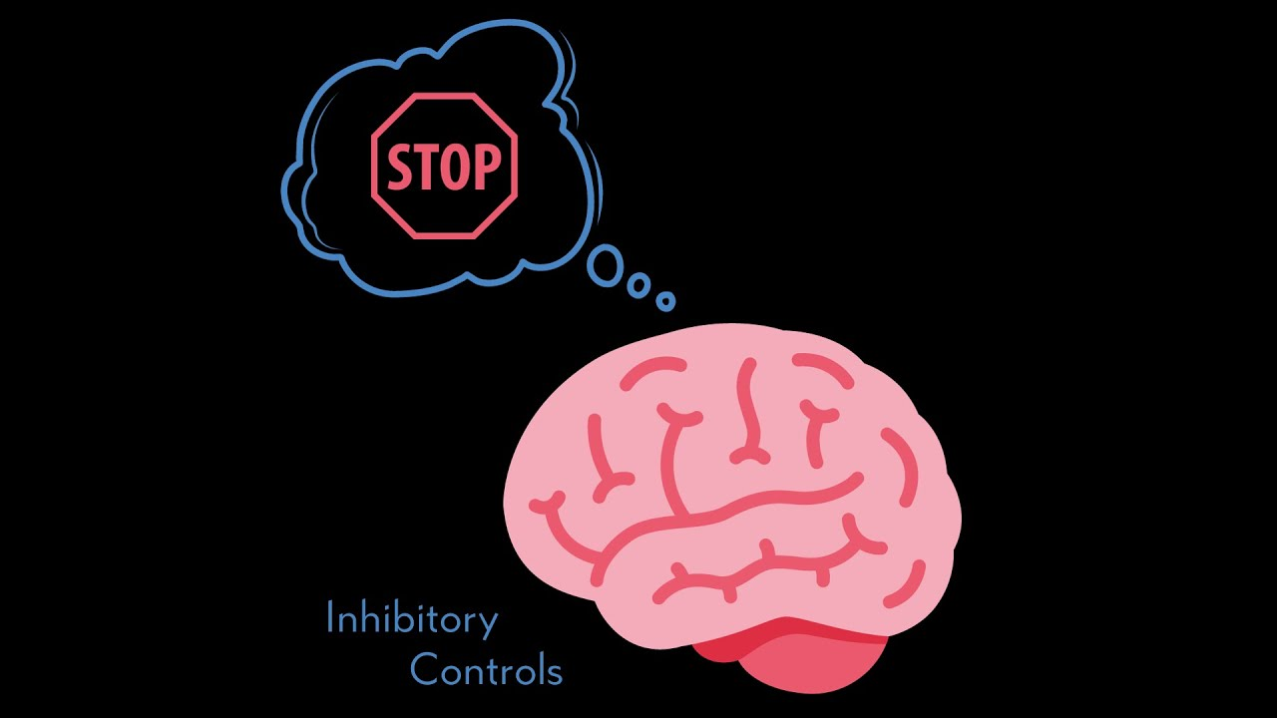
Inhibition Control
Develops from infancy and decline starts in 60s
Notes:
Inhibition or Inhibitory control

Slide 11
Infants/Toddler Preschool Elementary(6-11) Adolescence (12-18) Young adult (18-25)
*younger the age, the more youth look to caregivers for direction on ways to regulate
*Toddlers ability with self-soothing advances
*Preschoolers gain skills with waiting
*Preschoolers begin improving regulation when emotional
*Kinders can understand enough to gauge the ability of others
*School age inhibition becomes more proactive.
*School age can inhibit and reflect upon their actions with more awareness.

Slide 12
Why Executive Functioning?
Individual benefit
Societal benefit
Economic benefit
Academic achievement
Educated population
Positive behaviors
More stable communities
Improved whole body health
Healthier population
Productive & flexible workforce

Slide 13

Growth Mindset
Notes:
Research by Carol Dweck. A growth mindset is the belief that your abilities, intelligence, and talents can be developed through effort, learning, and persistence. It’s the understanding that your brain is like a muscle that gets stronger with practice and challenge.

Slide 14
Assessing Executive Functioning
H&P
Observational feedback
Specialty referrals
Formal testing
Predisposition, Past medical/surgical/family hx, sleep, activity, stress
Direct, screening materials for multiple settings
Psychiatry, Neurology, OT/PT
Neuropsychology
Notes:
NPT: verbal, paper/pencil, electronic. Digit span, Wisconsin card sort, Stroop test

Slide 15
Treatment Strategies
Mindfulness Training
Balancing Nutrition
Sleep Hygiene
Incorporating Exercise
Neurofeedback Training
Psychotherapy (individual, group, family)
Pharmacotherapy

Slide 16
Growth Mindset
-Seek intrinsic motivation
-Praise the process
-Reframe self-talk
-Learning cues
Notes:
Research by Carol Dweck. A growth mindset is the belief that your abilities, intelligence, and talents can be developed through effort, learning, and persistence. It’s the understanding that your brain is like a muscle that gets stronger with practice and challenge.

Slide 17
Treatment Strategies
Working memory
Put systems to work (step by step lists, calendars with details), items handy, sticky notes, tap into your learning skills
Cognitive flexibility
Getting started (small- smaller, breaks are allowed)
Progress? Is this serving the goal?
Inhibition control
Use tools to keep on task (visual timer, count backwards, overestimate, use cues)
Emotion regulation: name the feeling, use coping skills
*Challenge perfectionism
*Match tasks to energy
*Routine, rituals win
*Accountability helps
*Seasons & strategies change

Slide 18


