Slide 1


February 13, 2026

Slide 2
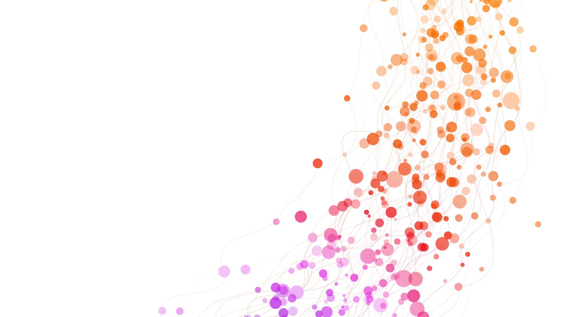
Friendship Foundations: Helping Children and Adolescents Build Healthy Social Skills and Connections
Erin Fiorito, LPCC-S
Molly Ireton, LISW-S

Slide 3

Foundation of Social Development
Social skills serve as one of the most vital tools for healthy development and lifelong success.
Human beings are inherently social creatures, wired for connection and communication.
Foundational for emotional well being, academic achievement and future career prospects.
The family serves as the child’s first social context
Social skills are developed through interactions with the environment, experiences, and examples modeled by family members or peers.
Individual differences, in the form of temperament, personality, neurodevelopmental factors (ADHD, ASD) will influence how children acquire and use social skills.

Slide 4
Social support is lacking for U.S. teens.
Only 58.5% of U.S. teens report “always” or “usually” receive the social and emotional support they need. (CDC)

Slide 5
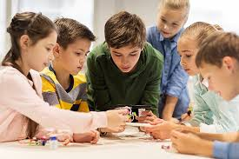
Why are social skills important?
Social skills are considered the “tools” children use to interact with others.
They act as the corner stone of healthy social and psychological functioning.
Early learning and application of social skills can increase confidence for youth when navigating more complex interactions like cooperation, conflict management and teamwork.
The development of strong social skills in children can lead to success in personal and professional environments as they grow older.

Slide 6
What are the skills that kids need to navigate social dynamics at home and school?
Communication Skills
Empathy
Teamwork
Conflict Resolution
Understanding Social Cues
Children and teens with ADHD tend to have a more difficult time with the following skills linked to successful social interactions:
Perspective taking
Situational awareness
Responding to others’ emotions (appropriately)
Initiating conversation
Cognitive flexibility
Appropriate use of humor

Slide 7
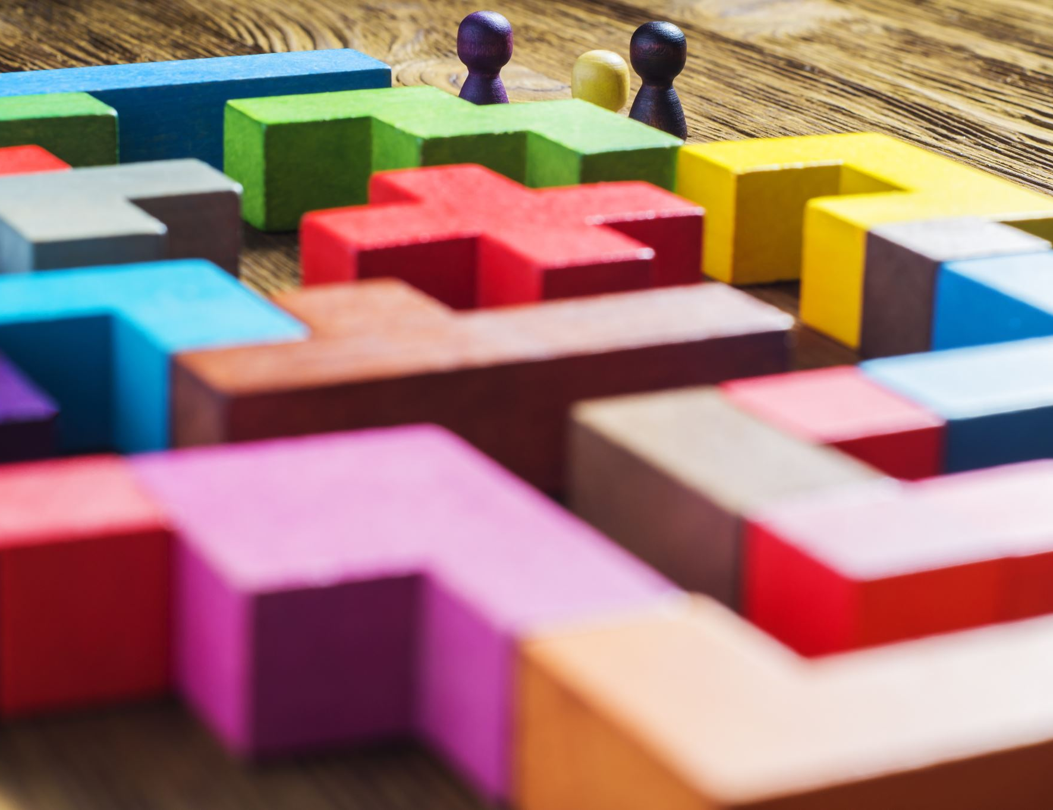
Can social skills be taught?
Social skills can be learned and improved at any age.
When learning new social skills, practice is key!
Professional intervention is available if needed.

Slide 8
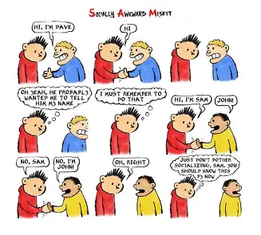
What do social skills struggles look like in children or teens?

Slide 9
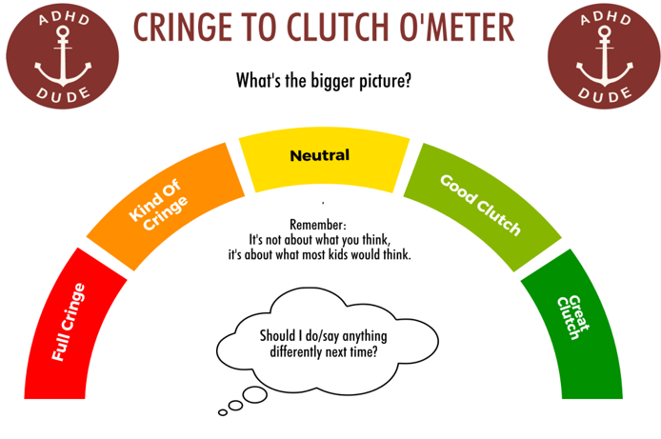
Common social challenges seen in children and teens
 | School-age Children (5-9)
 | One-sided conversations
 | Acting bossy or controlling with peers
 | Difficulty during unstructured time
 | “Smothering” a new friend
 | Trouble relating to same age peers
 | Unaware of how they come off to others
 | Can make, but not sustain friendships
 | Tweens and Teens (10+)
 | Retreating into video games/social media/or online realm.
 | Inflexibility
 | Criticizing peers
 | Only wanting to befriend “popular” peers who are not accepting of them
 | Little to no interaction with peers outside of school.

Slide 10
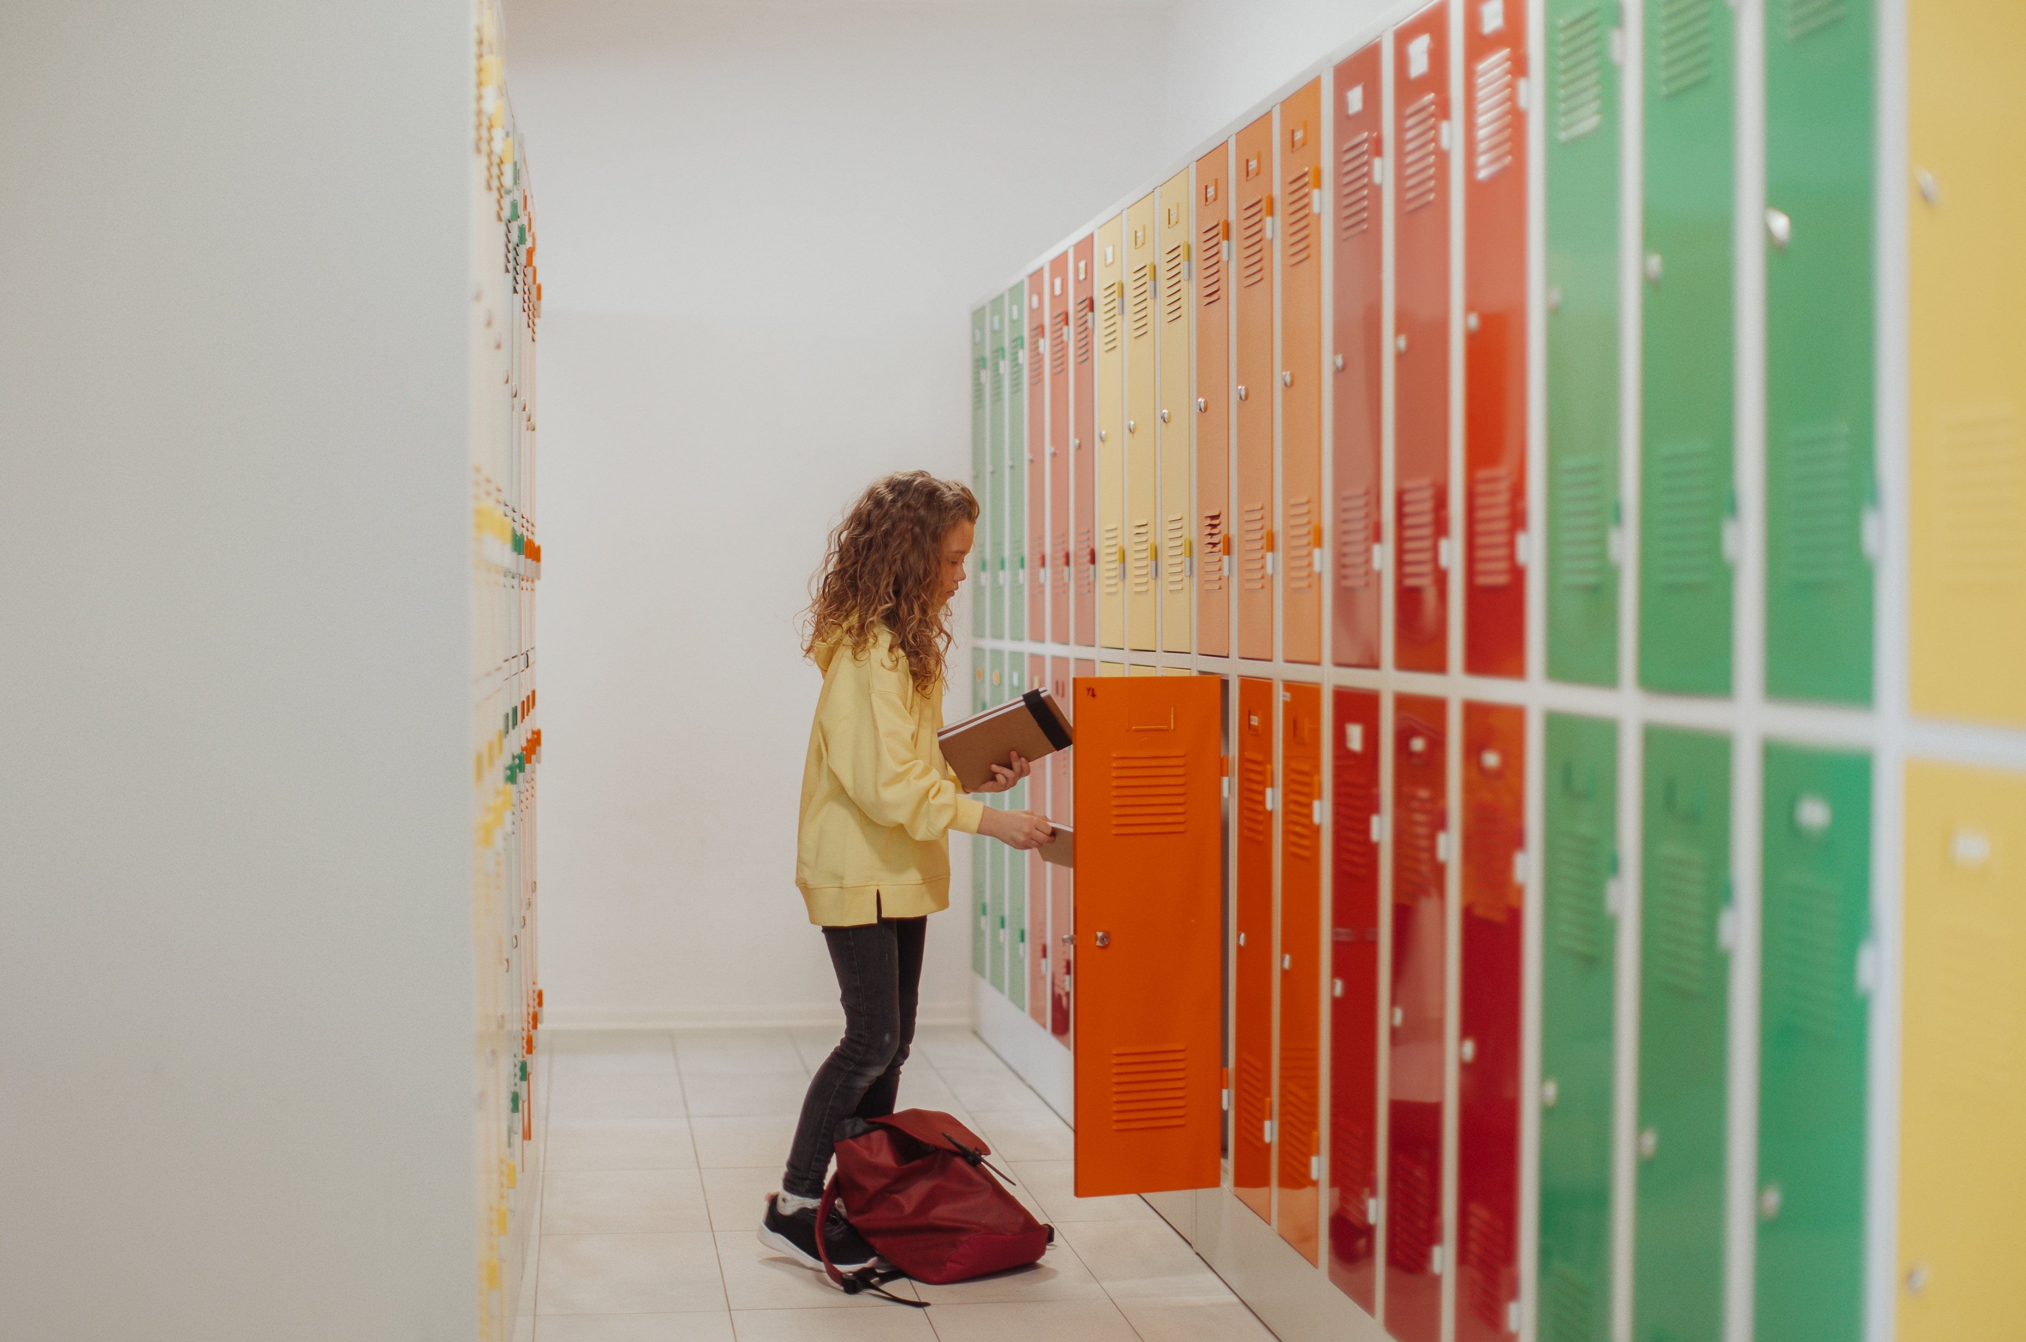
How does poor social skill development impact mental and emotional health?
Deficits in social skills during childhood or adolescence can lead to:
Risks of social isolation or loneliness
Bullying or peer rejection
Lack of social support, which is associated with poor health and sleep, and higher reports of anxiety, depression and low life satisfaction.
The WHO reports that 1 in 6 people worldwide is affected by loneliness.
Adolescence is a crucial period for developing social and emotional habits important for mental well-being.
There are higher risks of mental health concerns associated with LGBTQ+ youth, youth of color and girls.
The quality of our social interactions profoundly impacts our mental health, influencing everything from self-esteem to stress levels and overall life satisfaction.
Lower levels of anxiety, depression and loneliness are evident in youth who have strong social skills.

Slide 11
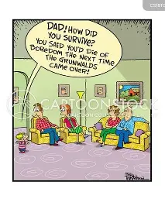
How can parents help their children develop social skills at home?
Modeling
Praise Efforts
Describe the context during social situations.
Practice
Leverage and highlight past social success
Reminders for Parents:
Don’t be surprised if children resist or act defensive.
Inconsistency is normal
Avoid measuring social competency by how a child interacts with family

Slide 12
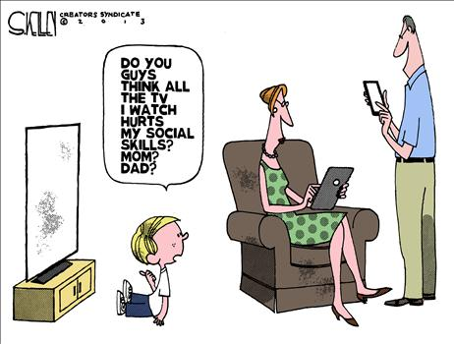
How does social media impact social skill development in youth?
Impacts time spent with “offline” friends.
Lack of exposure to non-verbal cues, leads to high risk of conflict and communication issues.
Offers additional practice and could enhance social skill development in some ways.
Lack of practice makes face-to-face interactions more intimidating.
Can impact self-esteem, mood and body image.
Online communication provides less opportunity for social “risk taking”.
Pushes kids to deal with complex social scenarios like being ignored.

Slide 13

Schools can be instrumental in helping to learn, develop and improve social skills.
Boost connection and belonging
Opportunities for social connection and practice.
Teachers play an important role in supporting youth.
Provide structured environments for children to encounter diverse social scenarios.
Extracurriculars offer additional opportunities for learning important skills.

Slide 14
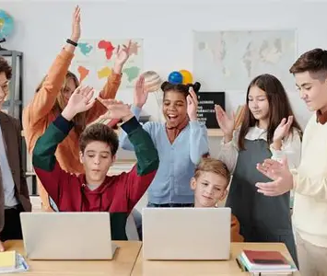
How can teachers and educators help promote social skills in the classroom?
Model positive social behavior
Provide opportunities for social interaction
Teach emotional awareness and regulation
Use role plays or social stories
Praise and reinforce efforts and progress

Slide 15

Questions or Comments
Contact Information:
Molly Ireton, LISW-S
Molly@footprints-therapy.com
Erin Fiorito, LPCC-S
elcounseling19@gmail.com

Slide 16

Springer School and Center empowers students with dyslexia, ADHD, and executive function challenges through four pillars: Springer Diagnostic Center, Springer Lower School & Middle School, Springer High School and Springer Learning Center.
Learn more at Springer-LD.org.

