Slide 1


February 13, 2026

Slide 2
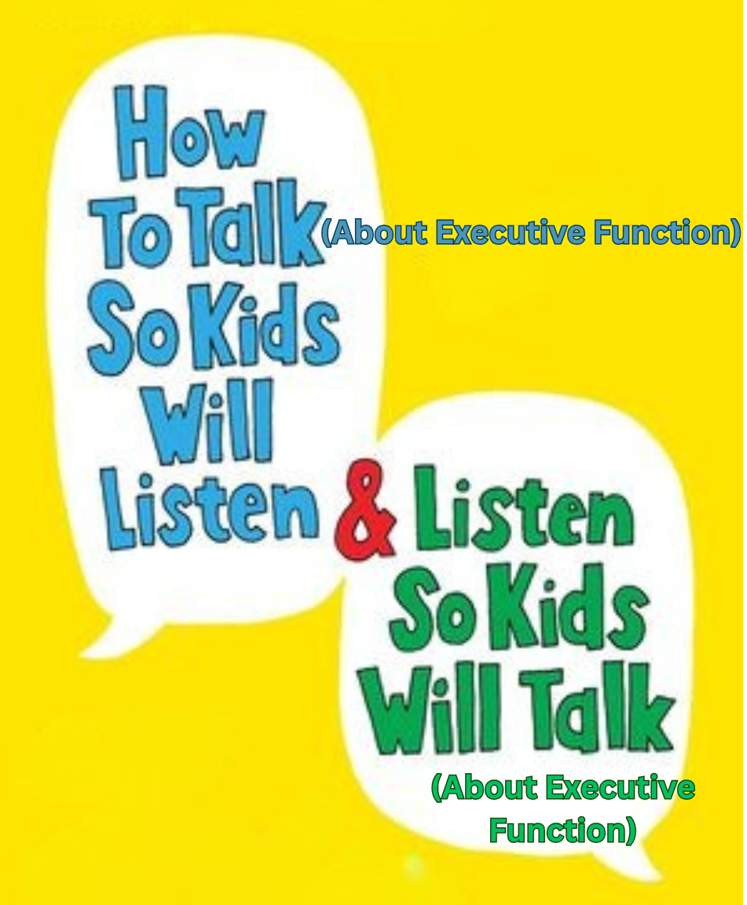
Presented by
Brooke Richart
Download handouts/slides here:

Slide 3





About me
Starting working with adolescents and teens in 2005: tutor, mentor, teacher, counselor
Cincinnati, Connecticut, Honduras, New York City, Northern Kentucky
10 Years as middle school intervention specialist
  1-year stint at Springer in the Peterson Department in the middle
Clinical Mental Health Counselor since 2022 for ages 8-25 out of pediatrician’s office and in private practice
LPCC in OH & KY; K-12 Intervention Specialist in Ohio, ADHD-Certified Clinical Services Provider
I’m a
Semi-Professional
at Getting Kids to Care About Things They Otherwise Wouldn’t!
Notes:
With all this experience, I have bestowed upon myself the most important, completely made up title being a semi-professional at getting kids to care about thing they otherwise wouldn’t!
From memorizing the preamble to the Constitution, to focusing on breathing when they really want to punch their sister, to getting a group of 30 7th graders to do sing and dance to T Pain song another teacher and I re-wrote to be about learning, And perform it front of their friends and family. And the least enthusiastic student told me “this is pretty good”- rave review.
Say semi- professional because there are always new challenges. When I started working with kids, the adults were the only ones with phones and I got a text once a month. Now,I need to understand Snap streaks and messaging through Roblox and what it means to the kids I work with

Slide 4
Session Objectives | Agenda
Learn a variety of strategies and modalities for introducing, teaching, modeling, and reinforcing executive function skills for students of all ages in a manner that is meaningful to them Address challenges you have encountered or anticipate with introducing executive function to students in a collaborative manner Earn your own honorary title of “I’m a Semi-Professional at Getting Kids to Care About Things They Otherwise Wouldn’t!” | Why it matters Brooke’s principles Framing the concept Topical & meaningful Basis in the brain Individual skills Make it personal Strengths and weaknesses Strategies What can have an impact on EF? Basic needs Siegel’s hand-brain model Mental health Motivation Intrinsic Extrinsic Circling back Application
A kid quote
A source quote
Sentence starters
To ponder
Notes:
Explain quotes

Slide 5
Actual responses Brooke has gotten when trying to introduced important concepts like EF, mindfulness, growth mindset…
Oh, I love mindfulness! That’s when they play classical music over the loudspeaker for ten minutes in the morning, and my friends and I talk to each other the whole time!
Ugh, Brooke, growth mindset?? They made us watch a cringe video on that during advisory. Do NOT even think about giving me a worksheet about it.
The millennial therapists on TikTok are always posting about executive function. Honestly, they are making you all look bad..
Notes:
These are life changing, paradigm-shifting concepts. For myself personally, understanding these had changed my approach to teaching, to counseling, to my own life.
Clearly we all passionate about EF since we are at an all-day conference about it … I worry we are not doing a good job passing this urgency, this passion to our students and clients
By the way millennial = uncool

Slide 6
Brooke’s Principles for Getting Kids to Care about EF
Focus on being topical, meaningful and connected
Let their understanding take the lead
Supplement with what you know
Be authentic
Lean in to desire for independence; set up motivators when this isn’t enough
Be pleasantly persistent

Slide 7
Framing Executive Function: Connect to the moment
How are you framing EF in your spaces?
What’s working and what’s not?
Adolescents are particularly sensitive to disingenuous or scripted responses and yearn for more authentic dialogue.
Field & Ghoston, 12
ABTEF (Always Be Thinking Executive Function)
When it stumbles or succeeds
When you or students/clients are utilizing it
When something else might be impacting it
Notes:
Ask audience
Depending on audience size ask what type of setting they work in
Important to connect it to their context, what they are experiencing here and now
This makes it real, rather than part of a pre-packaged curriculum

Slide 8
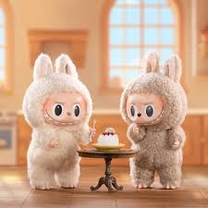

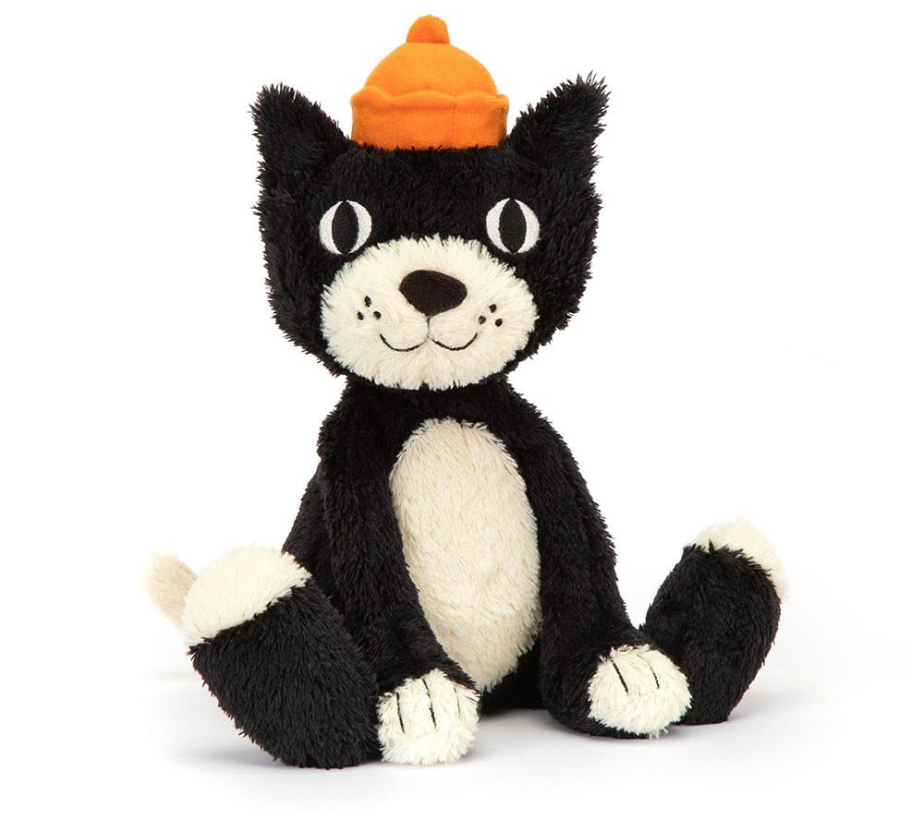
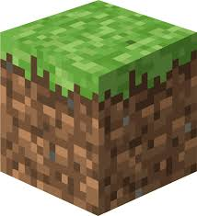
Framing Executive Function: Make it meaningful to them
School might not be the reason
What are their activities outside of school? Their interests?
Do they have goals or aspirations for when they grow up? For this weekend? For next year?
Reinforcement association: When [you talk] with a child about a topic of interest and demonstrates a familiarity with the topic, the child is more likely to become interested… and eventually become more open to discussing other topics… [you] must often spend time researching topics in popular culture.
- F & G, 9
Notes:
How many participants have future video game designers or professional athletes or makeup artists etc… what are the EF skills needed to accomplish these goals? Ef is not just for homework, it’s for accomplishing what we want to do in life; I use EF to be a better counselor
Kid pop culture quiz
Motivated to talk about hobbies and interests- this might be your way in, how is EF used in hobbies?

Slide 9
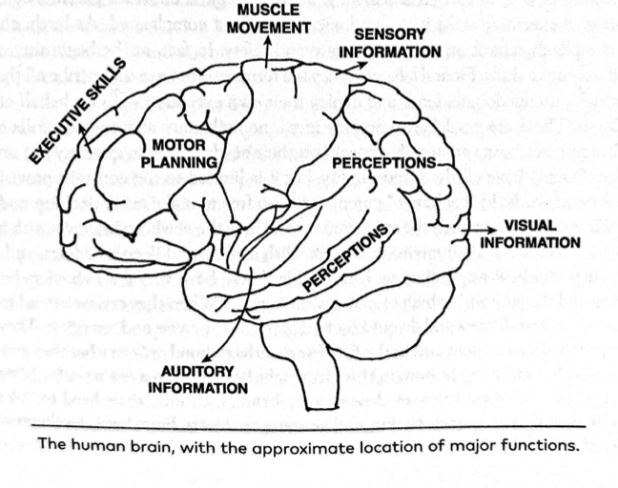
Framing Executive Function: Explain the Brain
Prefrontal cortex
Forehead tap
Still developing
Exists only as potential
Need experience to grow
Use it or lose it!
(Dawson, Guare & Guare 17)
Notes:
Simplified version- not neuroscientists
Makes it concrete, context of development is key, potential
Pruning
Any other connections to the brain?

Slide 10
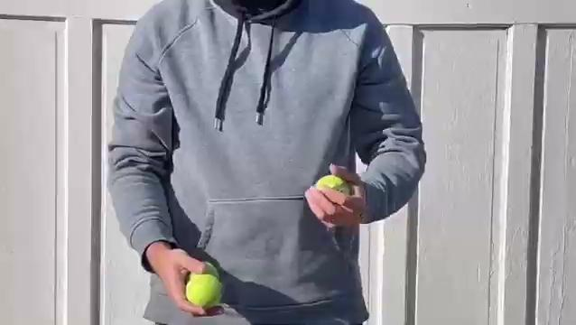
Framing Executive Function: Utilize metaphor
Metaphors serve as a means to teach, enlighten, and facilitate therapeutic progress. They help convey abstract concepts and ideas in a way that is easier to understand.
Salih, 82
Comparing working memory to…
Notes:
Metaphor goes both ways
Juggling metaphor

Slide 11
Framing Executive Function: Utilize metaphor
Executive Function Skill | Metaphor
Flexibility or shift Emotional regulation Response inhibition Working memory Organization Task initiation Foresight Hindsight | A volcano A cup of hot water Spinning plates Climbing a mountain Brakes Juggling Tanks of gas | Stop sign Blinders Mirror Google Maps Crystal ball Puzzle Or create your own!
Notes:
Notice that I am borrowing from multiple models for the skills
Have participants partner up and create metaphors, share out favorites

Slide 12
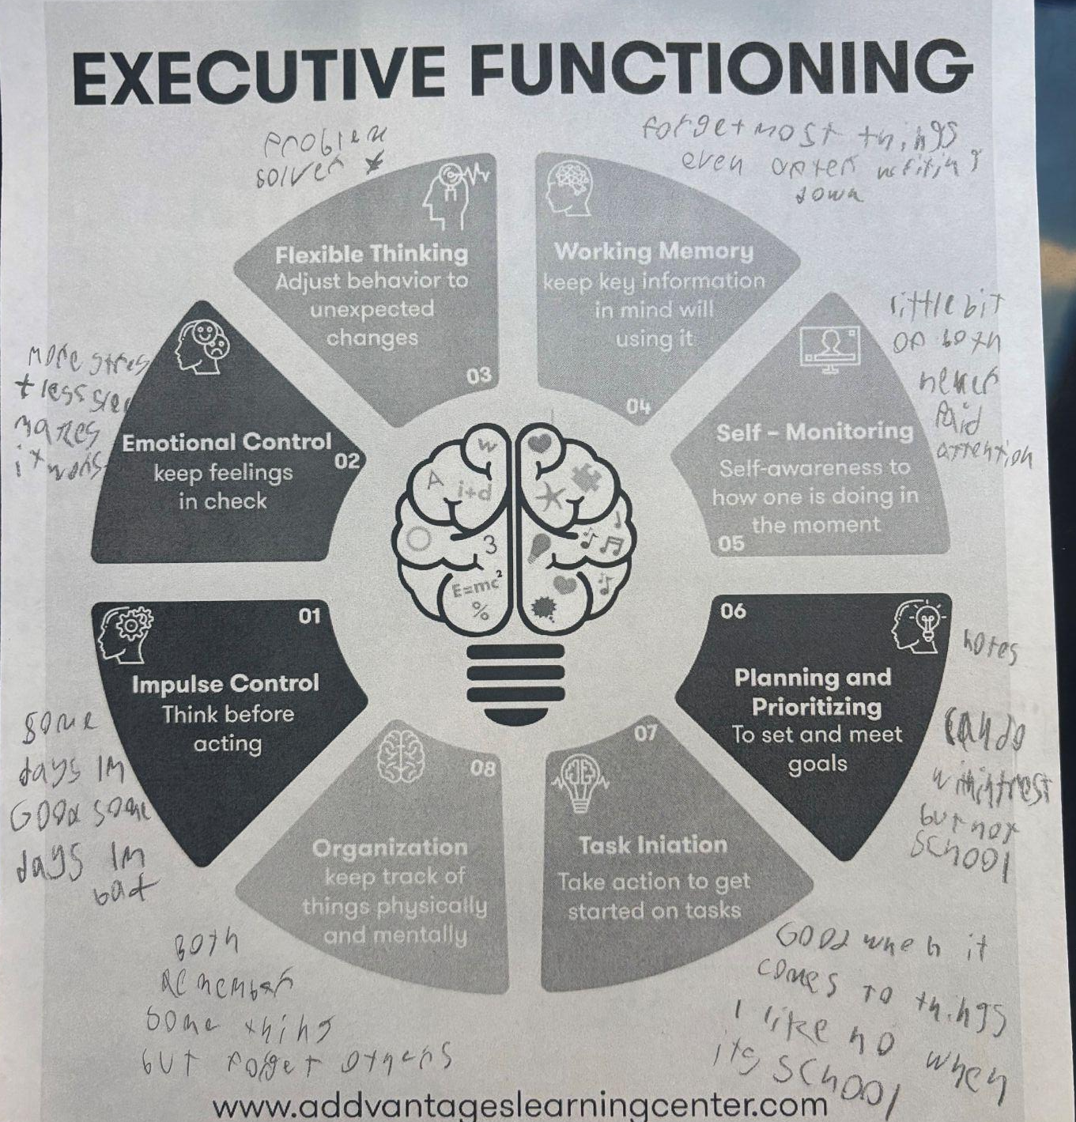
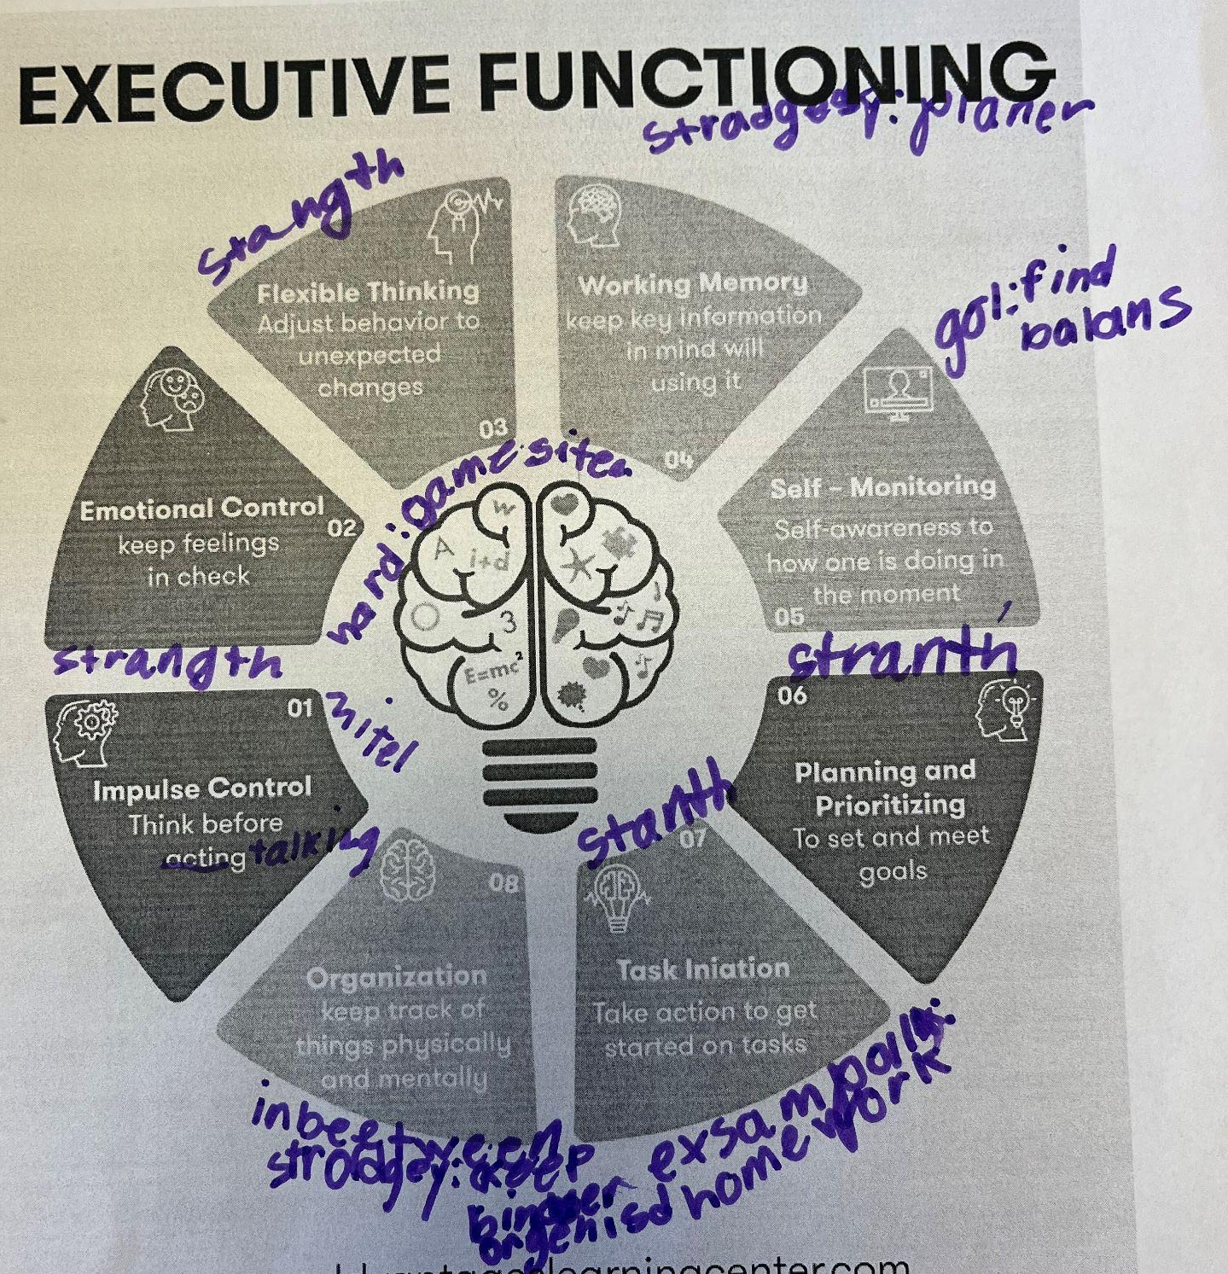
Make it personal: Strengths and weaknesses
Consider that children and adolescents often have a wisdom that is different from that of adults…
- F & G, 14
.
Notes:
What’s the definition of organization
Let them take the lead- maybe their understanding isn’t the same as Russell Barkley’s but I’m okay with them just thinking about it!

Slide 13
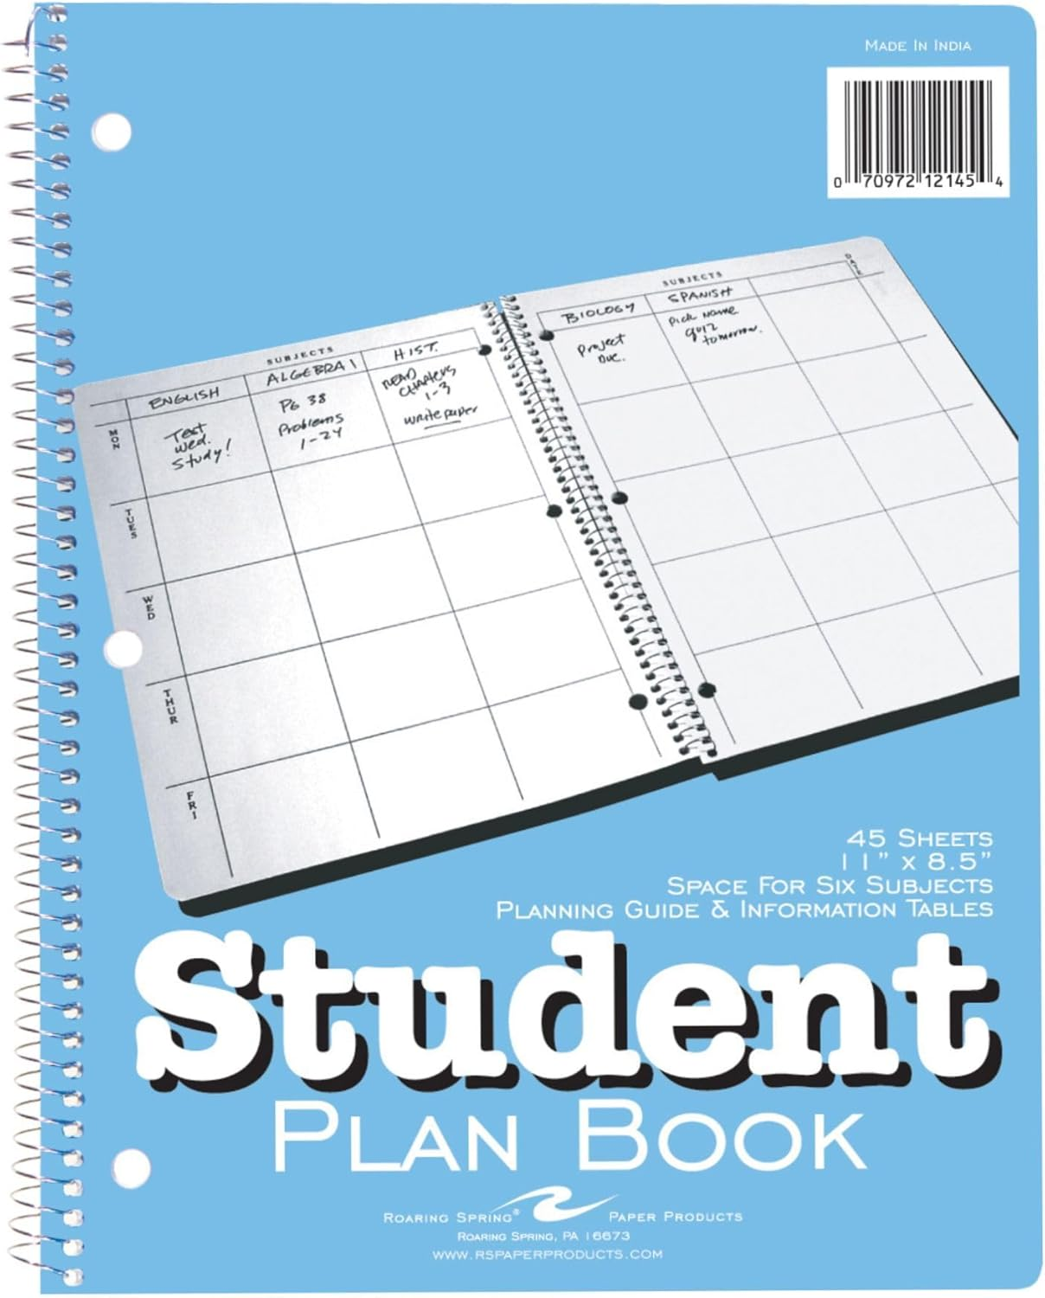
Make it personal: Develop personalized strategies
Common things I hear when it comes time to brainstorm supports and strategies:
They already make me do that.
I don’t know what would help.
I’ve tried that before; it didn’t work.
I set reminders on my phone and just ignore them.
That worked for like a week and then stopped.
Planners never work for me.
Notes:
How many of these have they heard?
Ask for any other ones they’ve heard
The dreaded student plan book

Slide 14
Make it personal: How NOT to Respond
Denial of feelings:
  I bet you do have ideas to help
  You probably just didn’t like that teacher/subject
  You don’t really mean that.
Do as I do/say
  Just use this reminder app like I do and you’d be able to keep track of your assignments
  Just use the orgnaizer bins I got you!
Rush to the solution/ ask too many questions
  Let’s just do this strategy.
  Have you tried _? What about _?
Notes:
This may seem silly, but this often how we respond to kids when they express a frustration or challenging emotion, I hear it every day; borrowed form F & M

Slide 15
Make it Personal: How TO Respond
EMPATHY
If our attitude is not one of compassion, then whatever we say will be experienced by the child as phony or manipulative. It is when our words are infused with our real feelings of empathy that they speak directly to a child’s heart.
Faber & Mazlish, 14
Acknowledge the emotion, the effort, the challenge
Act as a partner, not the boss
Ask for a part that worked
Throw out ideas as options: “here’s what other people have tried.”
Get creative, get silly
Be patient
A kid-created strategy that’s dicey > an adult-created one that’s flawless
Notes:
18 post it notes between your room and the bathroom
Poop emoji reminder = do math homework
Nothing growing or smelly = a clean room
Patient example- a full session to come up with ideas for reminders that would work for ¾ days of the week; let them come up with a symbol that they’ve checked their homework folder

Slide 16
Make it Personal: Let them create the strategies
EF issue: Client is not remembering to take his antidepressant in the morning before school
Responses:
I don’t have a phone to set reminders
I don’t have a consistent morning routine
No one else is awake to remind me to take my meds
There’s nowhere to put a sticky note that I will definitely see
Eventual solution:
→ The new kitten meows very loudly for breakfast each morning.
→ The client feeds the cat and wouldn’t forget to do so because of said meowing.
→ Cat food is located in the fridge.
→ Put the meds next to the cat food in the fridge, so he will remember to take them.
Notes:
This is a big issue, past issues with SI, recently lost an older sister to suicide, winter has historically been a challening time for him
Time elapse: 55 minutes, easy to respond with advice, denial of feelings, impatience,
Insert cat picture?!

Slide 17
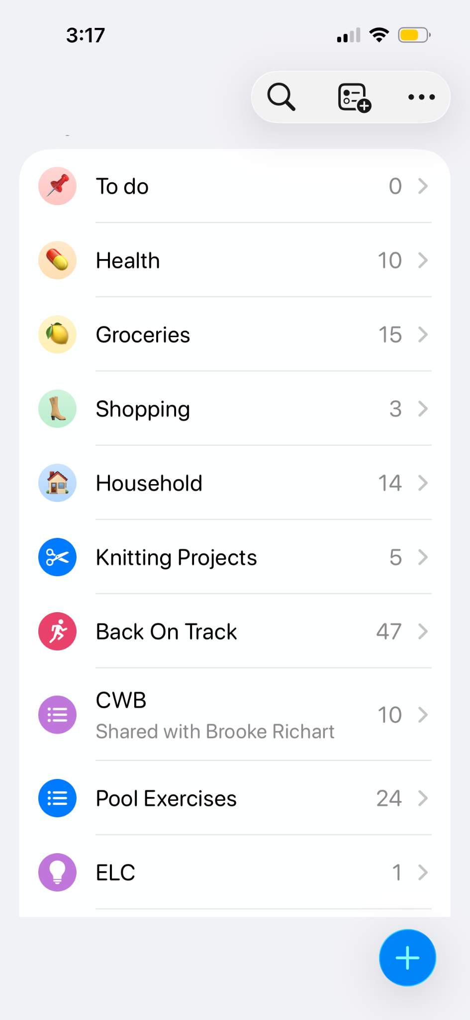
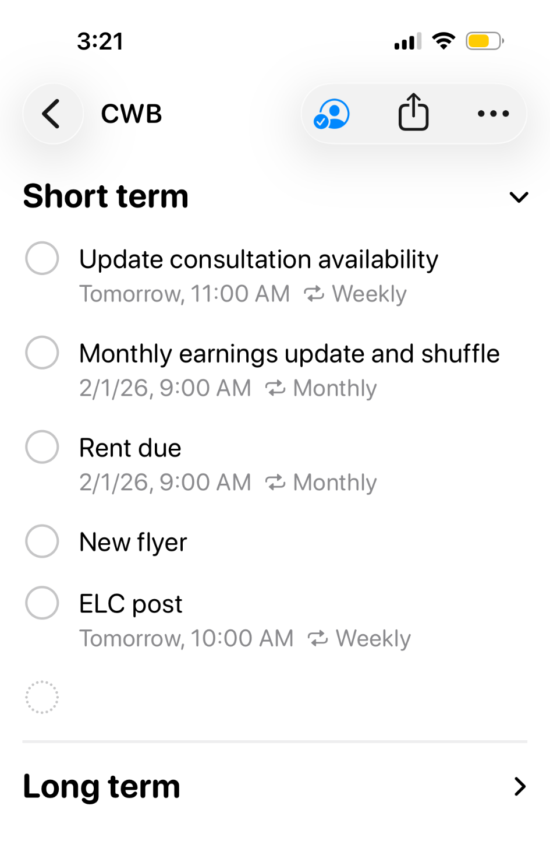
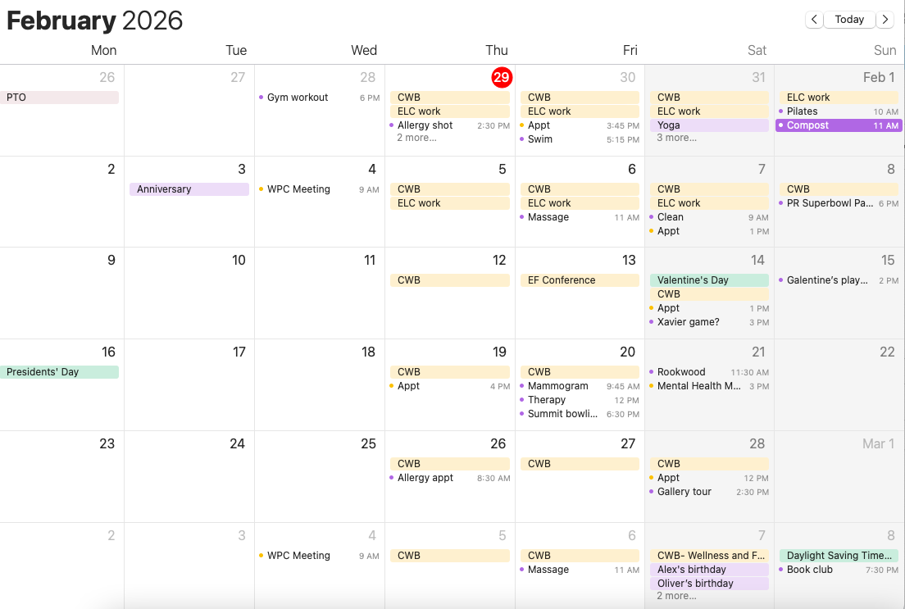
Make it Personal: Model your own strategies
Notes:
Kids should know that this is a lifelong journey/ work in progress
Share that my working memory is my weakness- if it’s not written down, it will bounce around in my head and stress me out. So I have 10 + lists and sublists and reminders and color coded calendars. Is it Instagram worthy? No. But it allows me to sit in a session with a client and be fully present and that’s what matters most to me.
The point being that EF strategies help you manage the things you have to do so you can do the things you want to do.

Slide 18
What can impact EF?
OCD
Anxiety & depression
Substance use
Sensory overwhelm
Illness
Basic needs
Trauma
Stress & Threats
Short-term and long-term
Grief
ADHD
Learning disabilities
Age & development
Emotional Dysregulation
TBI
Environment
Intellectual disability
ASD
Notes:
Brainstorm on chart paper or board
Categories: IEP/504, exists only as potential, mental health, basic needs, emotions
Stress= activation of sympathetic nervous system- automatic, limbic system not frontal lobe
Why? Not static Kids appreciate knowing that it it not something that stays the same all day everyday. When they mess up, they can noticed the factors/context that may have contributed and change it for next time. Or it might give them a context.

Slide 19
What Can Impact EF? Basic Needs
Sleep
Food & diet
Clothing
Water
Basic needs
Activity & exercise
Safety
Shelter
Notes:
Clients always look at me strangely when I ask about these things, but without them, EF isn’t going to work
Depending on the population you work with, some of these might not be a concern, but sleep should always be discussed, diet, exercises
Kids tells me EF challenges- up all night, not eating breakfast
Sleep hygiene, food as fuel
Exercise- generates proteins which support neuron growth in the brian which in turn supports working memory

Slide 20
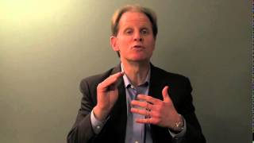
What Can Impact EF? Emotional dysregulation
→ Dr. Dan Siegel
Hand-Brain model
Upstairs/downstairs brain
Flipping your lid
How does this connect to EF?
Notes:
https://www.youtube.com/watch?v=qFTljLo1bK8
One way to connect to upstairs and downstairs brain is through movement- importance of exercise again

Slide 21
What Can Impact EF? Mental Health
On your handout: DSM-5-TR Diagnostic Criteria for Generalized Anxiety Disorder and Major Depressive Disorder
What parts of the criteria are directly related to EF?
What parts of the criteria will impact EF?
Do you notice anything they have in common?
TALK TO KIDS ABOUT THIS
I guess I’m just lazy.
→ GAD score of 10 (moderate anxiety)
→ PHQ score of 17 (moderate-severe depression)
Notes:
Client struggling with task initiation/ chores at home, maintaining healthy habits- would make a plan with me and then not follow through
Went over the criteria with them, talked about EF to reframe this

Slide 22
Motivation: Intrinsic
Competence, self-control, and a desire for relatedness are powerful intrinsic motivators; and intrinsic motivators are superior to extrinsic in creating lasting behavioral change
D, G & G, 63
Encourage autonomy.
F & M, 142
What would happen if you didn’t do __?
When you’re 16/ 18/ 25/ 32, do you still want ___ to be helping you with __?
What would it take for you to do that on your own?
What’s in between you and getting what you want?
What EF skills will you need for your goals? How can we build them now?
Notes:
Sometimes we need a little help uncovering that intrinsic motivation
Last one is more high level

Slide 23
Motivation: Extrinsic
When children and teens are working on behaviors that are hard for them… rewards for interim steps help to sustain motivation for what may seem like a distant long-term goal
Cooper-Kahn & Dietzel, 98
The incentive is there to ensure that there’s a payoff for the child for expending the effort it takes to complete the task.
D, G & G, 63
Tedious, boring, and effortful
  Acknowledge this instead of denying the feeling
First—> then
  Have-tos, then want-tos
Empowered extrinsic motivators or what I call self-bribery
  Model your own
Notes:
Empower the kids to set up their own rewards system and model your own
What do most adults do when kids say this is hard or boring?

Slide 24
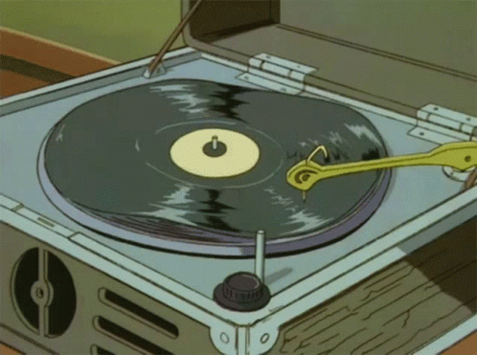
Circle Back
ABTEF
When it stumbles or succeeds
When you or students/clients are utilizing it
When something else might be impacting it
Following up on strategies, making adjustments and noting successes
“That sounds like what we talked about last time.”
“I wonder if there’s a connection between __ and __.”
“How could __ be impacting your executive function in that moment?”
“What do you think was going on in your brain when that happened?”
Notes:
Demonstrates that it’s not just a one-off concept; it’s in everything!

Slide 25
Application
Apply this to a group or classroom setting
Model with a think aloud Model with a student Think-pair-share Name specific EF skills needed for classwork | Students confer with each other Accountability buddies Conferencing
Collaborative problem solving/ Q & A
What challenges do you anticipate in getting kids to listen and talk about EF?
Any questions?
Notes:
Work together to problem solve

Slide 26


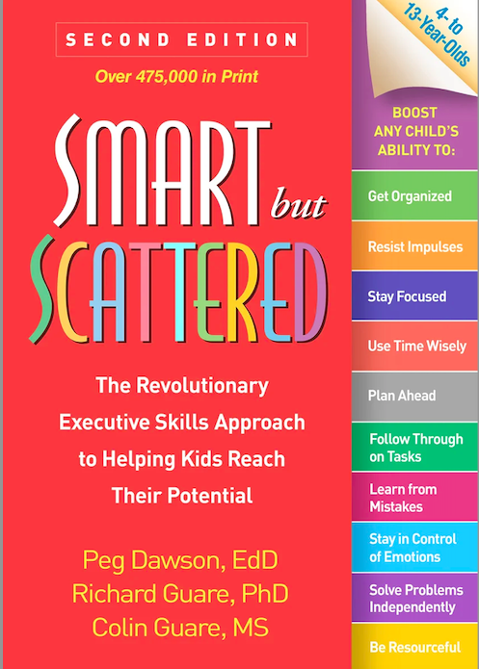

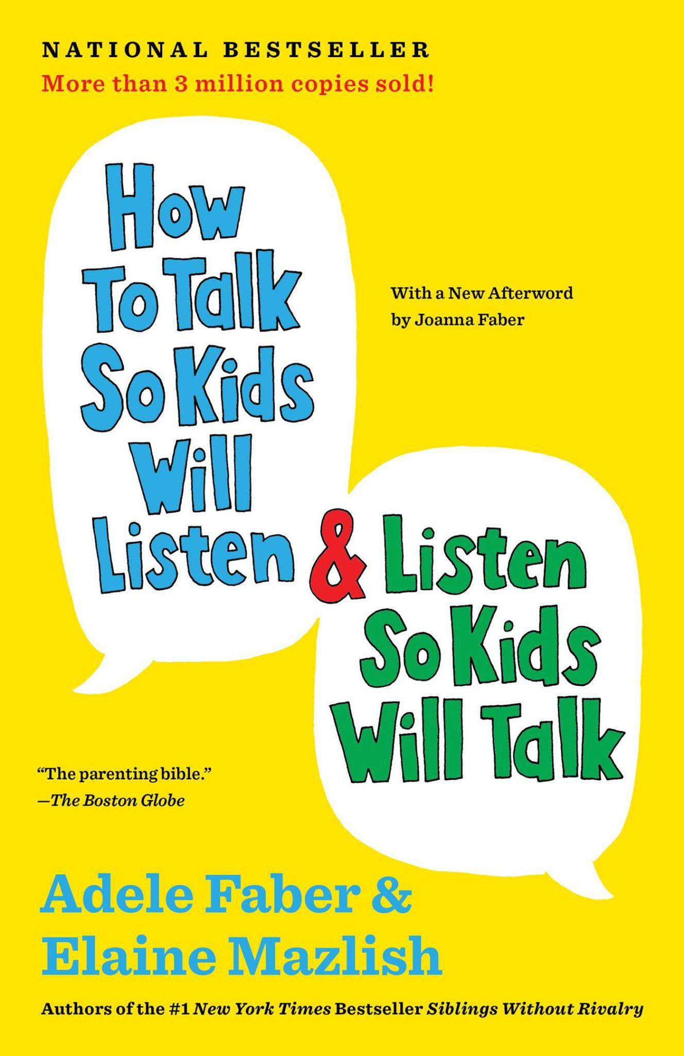


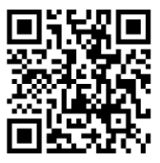
My sources
Let’s connect!
counselingwithbrooke.com

Slide 27

Springer School and Center empowers students with dyslexia, ADHD, and executive function challenges through four pillars: Springer Diagnostic Center, Springer Lower School & Middle School, Springer High School and Springer Learning Center.
Learn more at Springer-LD.org.

